Slide 1
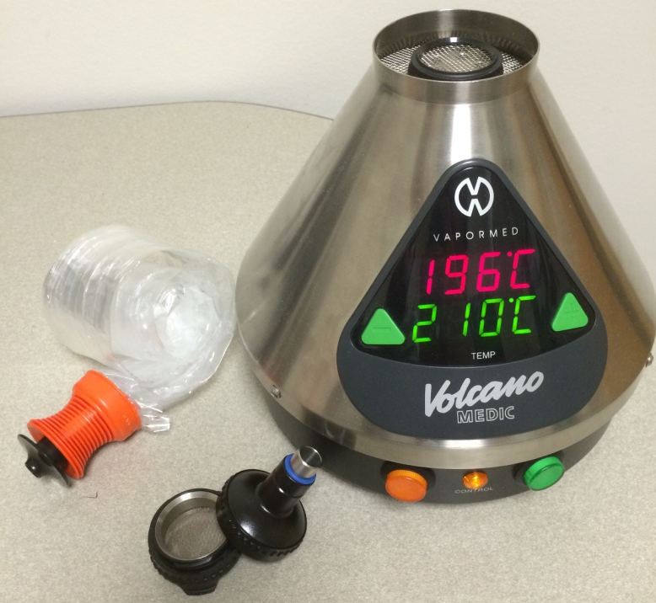
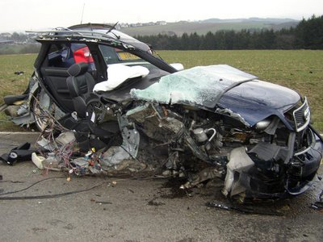
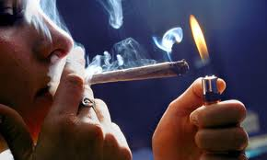
Cannabis Impaired Driving:
A Short Term Consequence of Cannabis Medicalization & Commercialization
Smart Approaches to Marijuana Summit
Atlanta, GA April 5, 2018
Professor Dr. Dr. (h.c.) Marilyn A. Huestis
Lambert Center for Study of Medicinal Cannabis & Hemp
Thomas Jefferson University, Philadelphia, PA

Slide 2
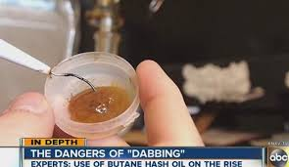
Short Term Consequences of
Medical & Legal Cannabis
Increased driving under the influence of cannabis, with increasing morbidity & mortality
Decreased perception of risk of using cannabis
Increased emergency department visits by adults & children from accidental exposure
Increased admissions for cannabis
dependence treatment
Medical cannabis may prove safe
& effective for treatment of some
diseases with unmet clinical needs

Slide 3
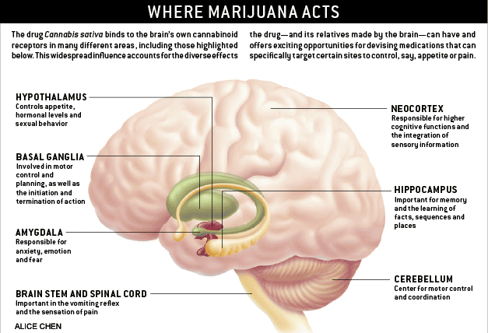
High CB1 Receptor Density
Hypothalamus
Appetite, Hormones
& Sexual behavior
Neocortex
High cognitive function
& Sensory data integration
Basal Ganglia
Motor control
& planning
Hippocampus
Memory &
Learning
Amygdala
Anxiety, Emotion
& Fear
Cerebellum
Motor control
& coordination
Brain Stem
& Spinal Cord
Vomiting reflex & Pain sensation

Slide 4
Executive Function
Attention | Selectively attending to 1 cue while ignoring others, including divided & sustained attention
Concentration | Intense mental application
Decision-making | Process of selecting a course of action
Impulsivity | Initiation of behavior without adequate forethought
Inhibition | Imposing restrain on behavior or another mental process
Reaction Time | Lapse of time between presentation of a stimulus & a response
Risk Taking | Engaging in behaviors that have the potential to be harmful or dangerous
Verbal Fluency | Generating multiple, verbal responses associated with a specified conceptual category
Working Memory | Ability to hold & manipulate information & remember it after a short delay

Slide 5
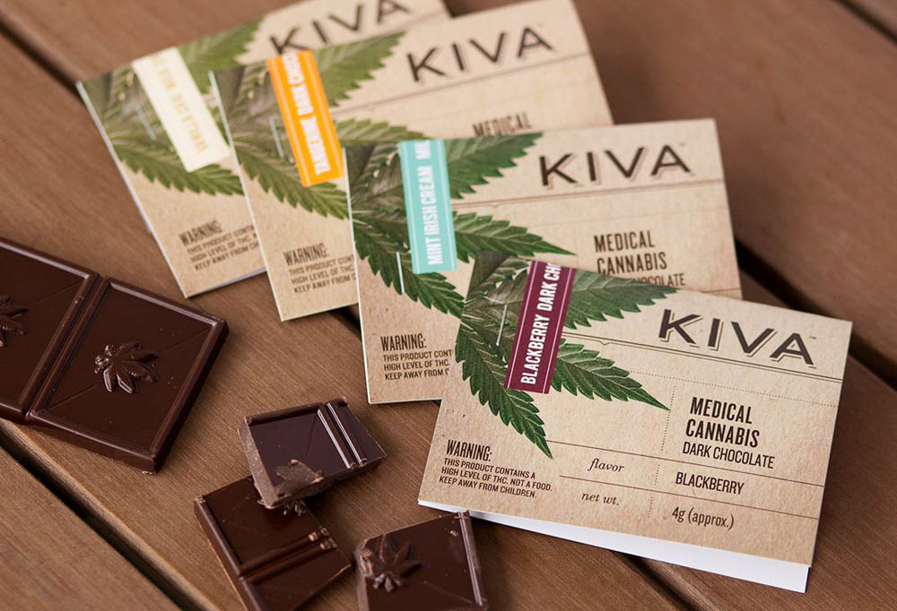
Psychomotor Function
Relationship between cognition & physical movement
Impairment in psychomotor function can limit
  Movement & Coordination
  Manipulation & Dexterity
  Grace
  Strength
  Speed
Cannabis impairs psychomotor performance
Notes:
All of these are related to driving

Slide 6
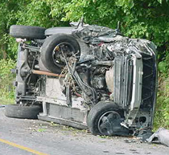
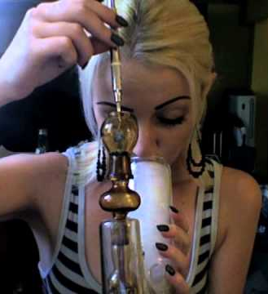
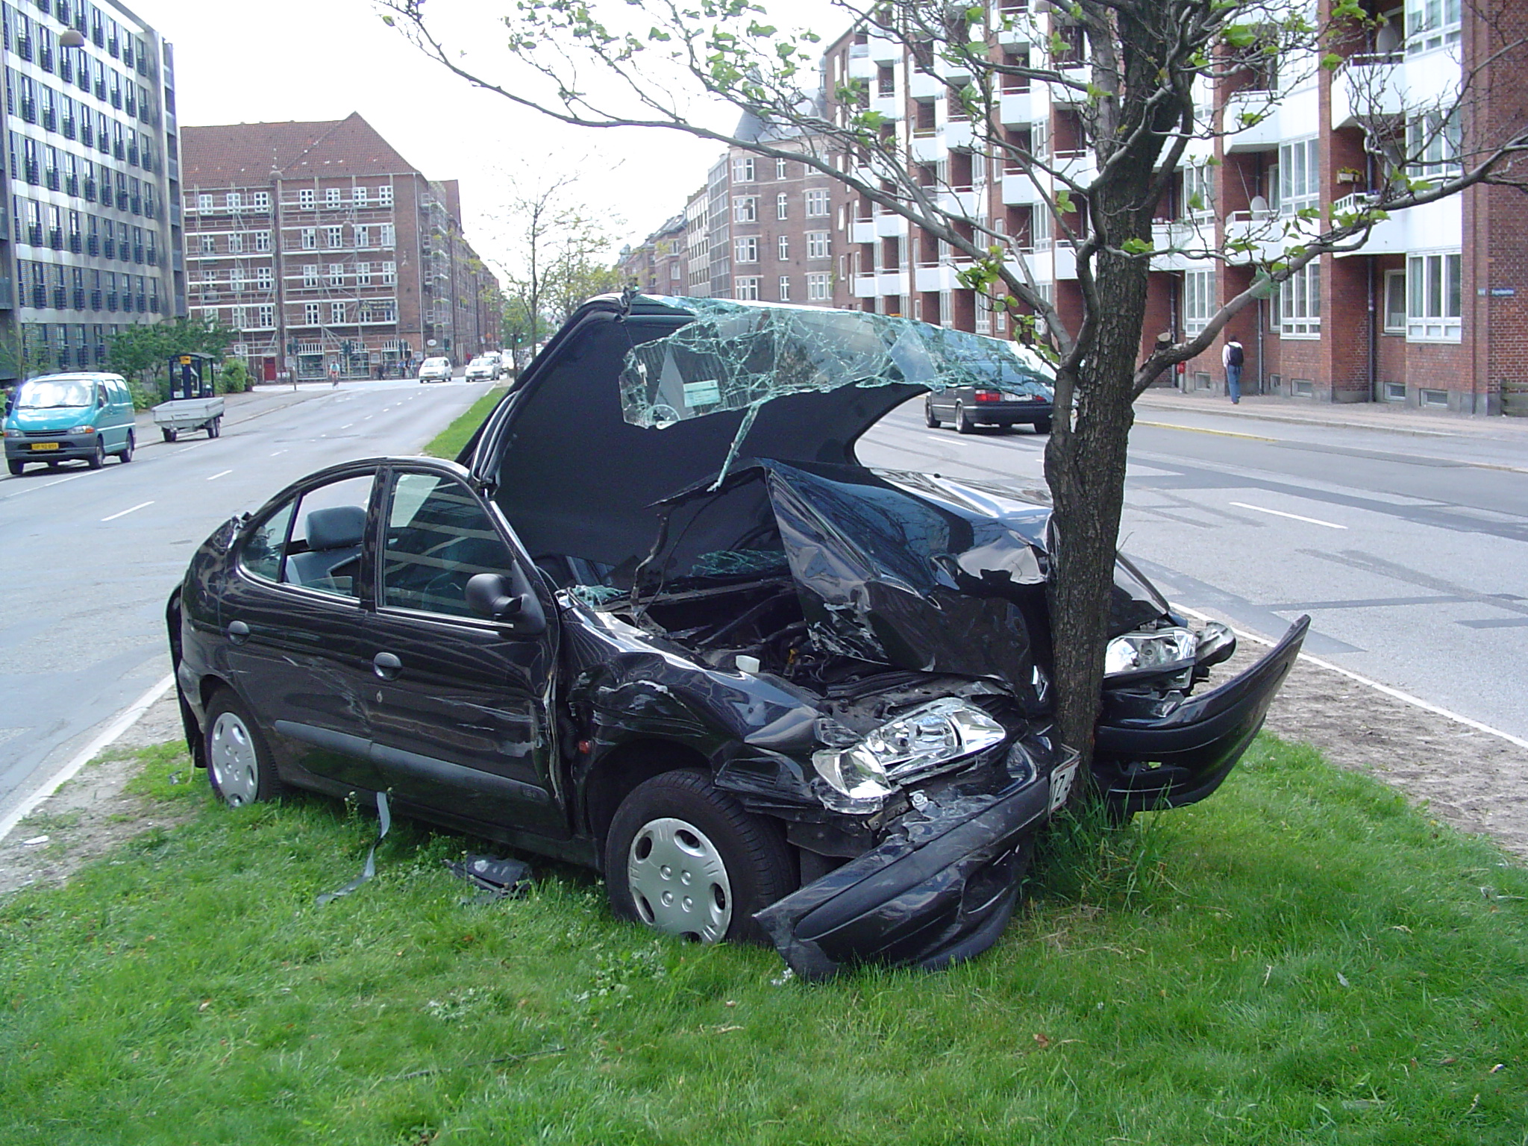
Smoking Cannabis Increases Motor Vehicle Injuries & Deaths

Slide 7
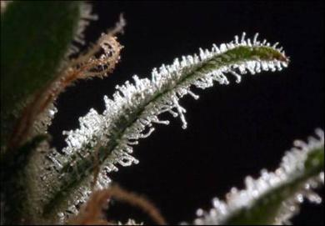
Drugs & Driving
2007 US National Roadside Study
  For 1st time, determined prevalence of alcohol (breath) & drug-involved driving (oral fluid & blood) during random traffic stops
  8.6% weekend night drivers cannabinoids positive
2013-2014 US National Roadside Study
  12.6% weekend night drivers cannabinoids positive, a 48% increase
Cannabis primary drug in US drugged driving cases & fatal motor vehicle accidents

Slide 8
CO Bureau of Investigation DUID Cases 2016 Dan Anderson, Chief Toxicologist
Drug | Cases | %
THC/Metabolites * | 1,423 | 70.6
Methamphetamine | 361 | 17.9
Alprazolam | 205 | 10.2
Clonazepam/7AC | 178 | 8.8
Cocaine/metabolites | 131 | 6.5
Diazepam/Nordiazepam | 109 | 5.4
Lorazepam | 86 | 4.3
Oxycodone | 78 | 3.9
Morphine | 58 | 2.9
Zolpidem | 55 | 2.7
Carisoprodol/Meprobamate | 38 | 1.9

Slide 9
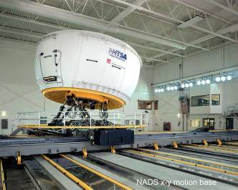
Effects of Cannabis & Alcohol on Driving
World’s most advanced driving
simulator never utilized for illicit
drugs
Determine effects of inhaled
cannabis with & without low
dose alcohol on driving performance

Slide 10
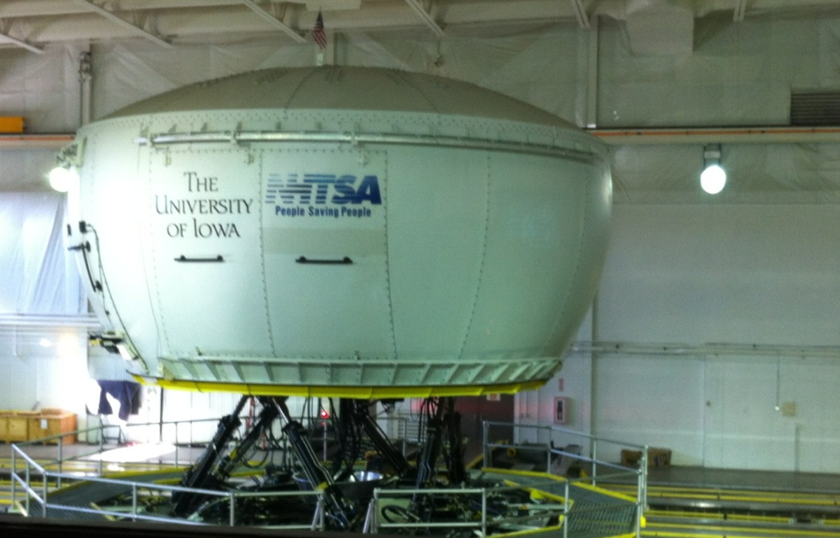
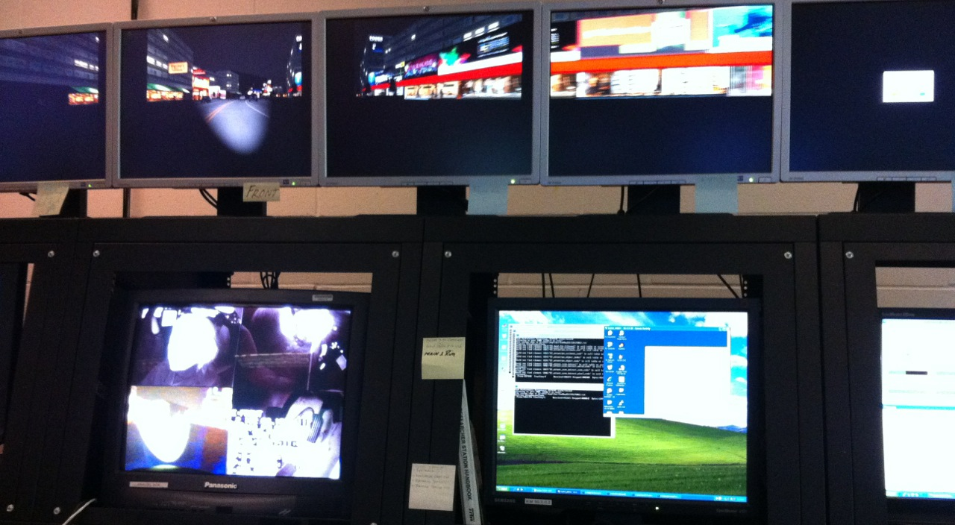
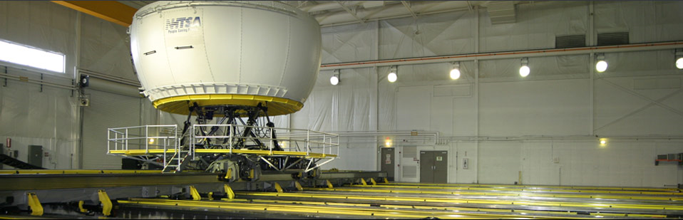
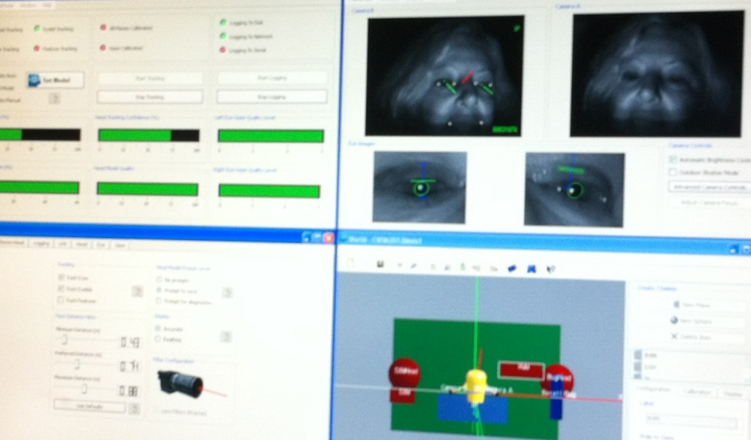
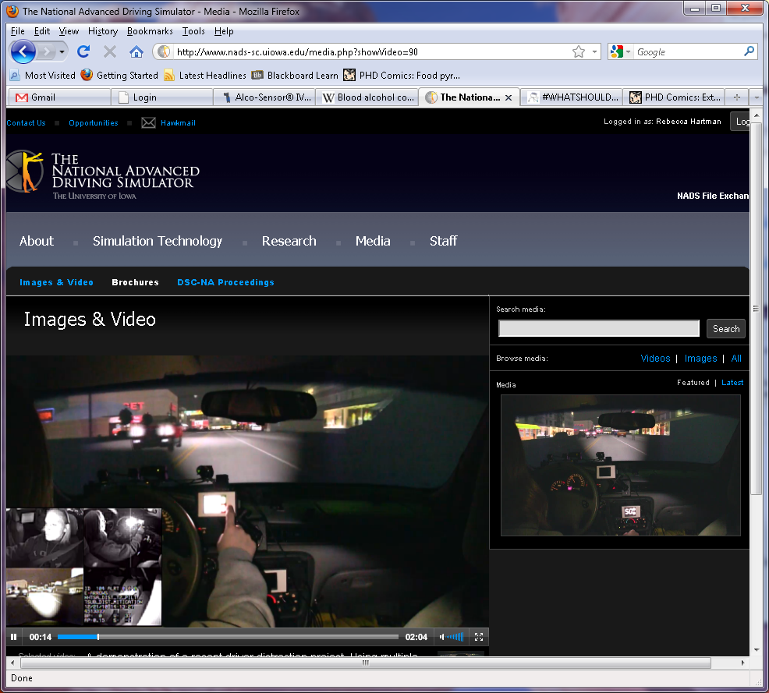
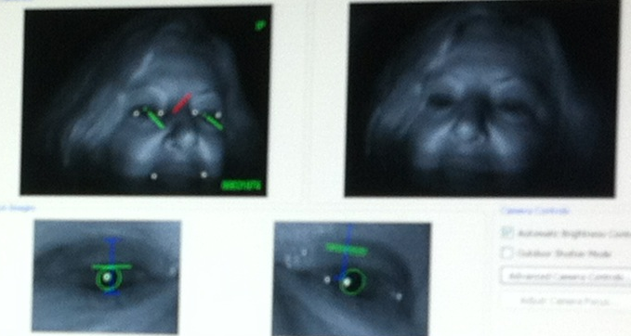
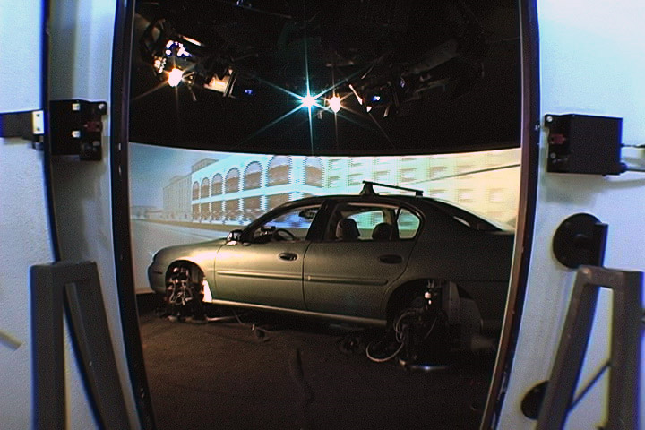
National Advanced Driving Simulator University of Iowa
Notes:
Sat in it myself. Can feel everything. Gravel, etc. Accelerate throughout this room—can feel turns, braking, everything
As realistic as possible w/o the street
Dome with sedan mounted inside
High-frequency vibration actuators
Turntable with 330° rotation each way
Hexapod for pitch, roll, yaw
Room size = airplane hangar

Slide 11
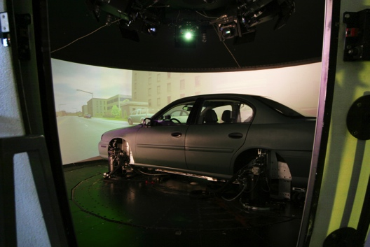
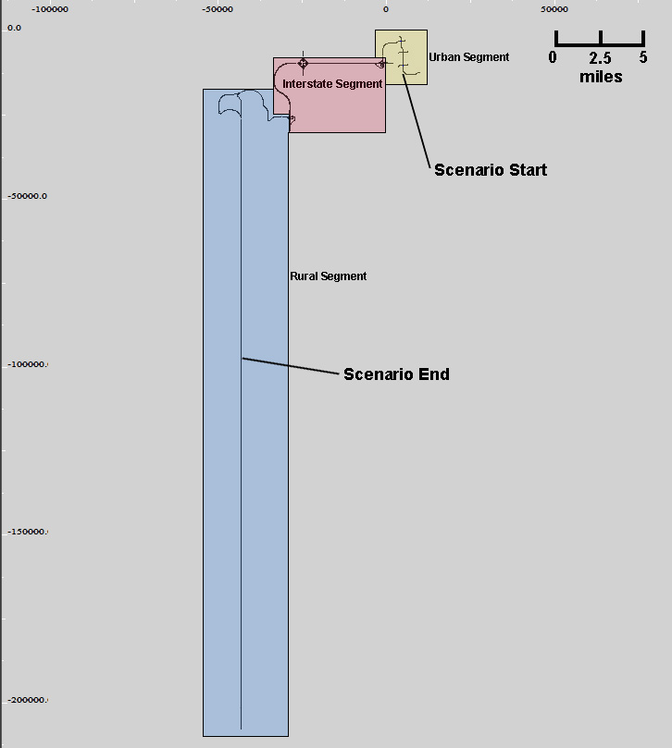
Iowa Study Simulations
Nighttime driving
3 segments:
  Urban
  Interstate
  Rural
Each segment contains subtasks
Drive time ~45 min

Slide 12
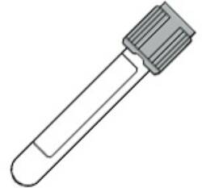
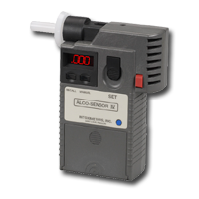
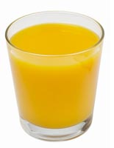
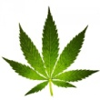

Procedures
Blood THC
  Solid-Phase Extraction
  LCMSMS
  LOQ 1 μg/L
Breath Alcohol
  Alco-Sensor IV (Intoximeters)
  g/210L ≈ BAC
10 min
25 min
85 min
140 min
-10
0
10
30
75
120
min

Slide 13
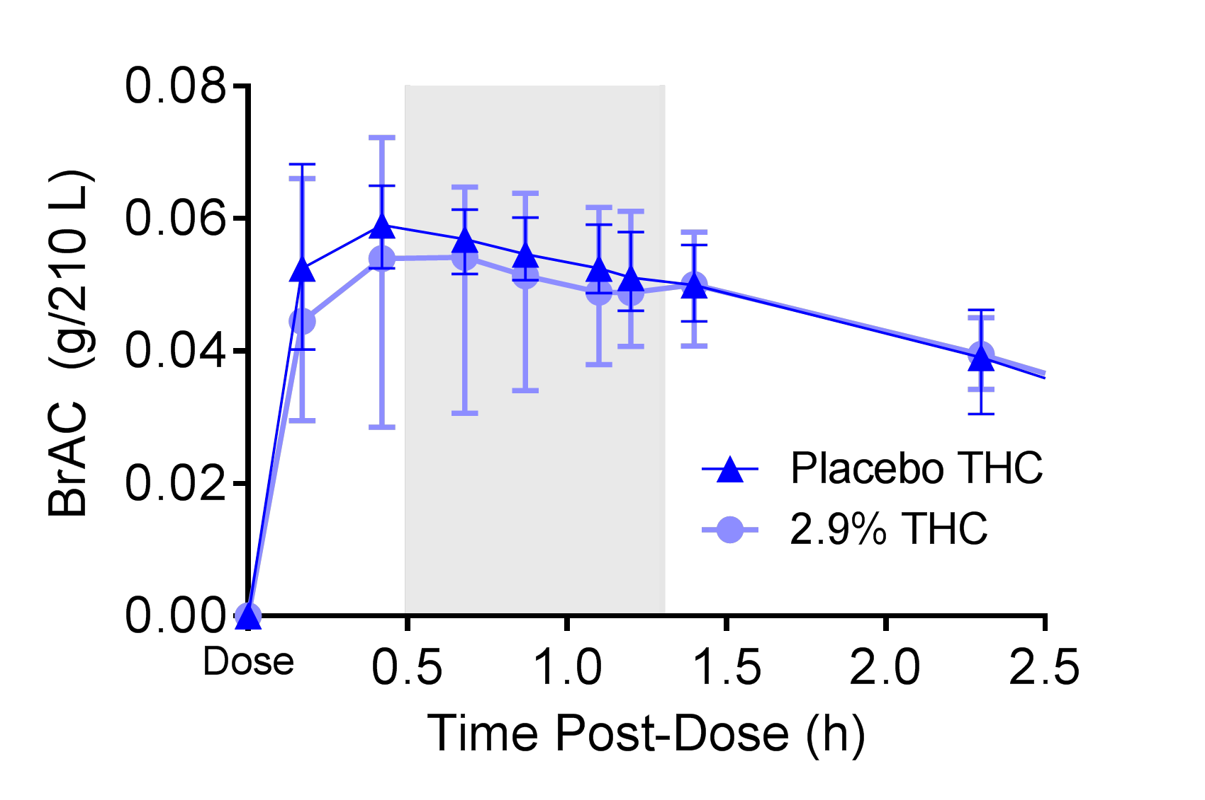
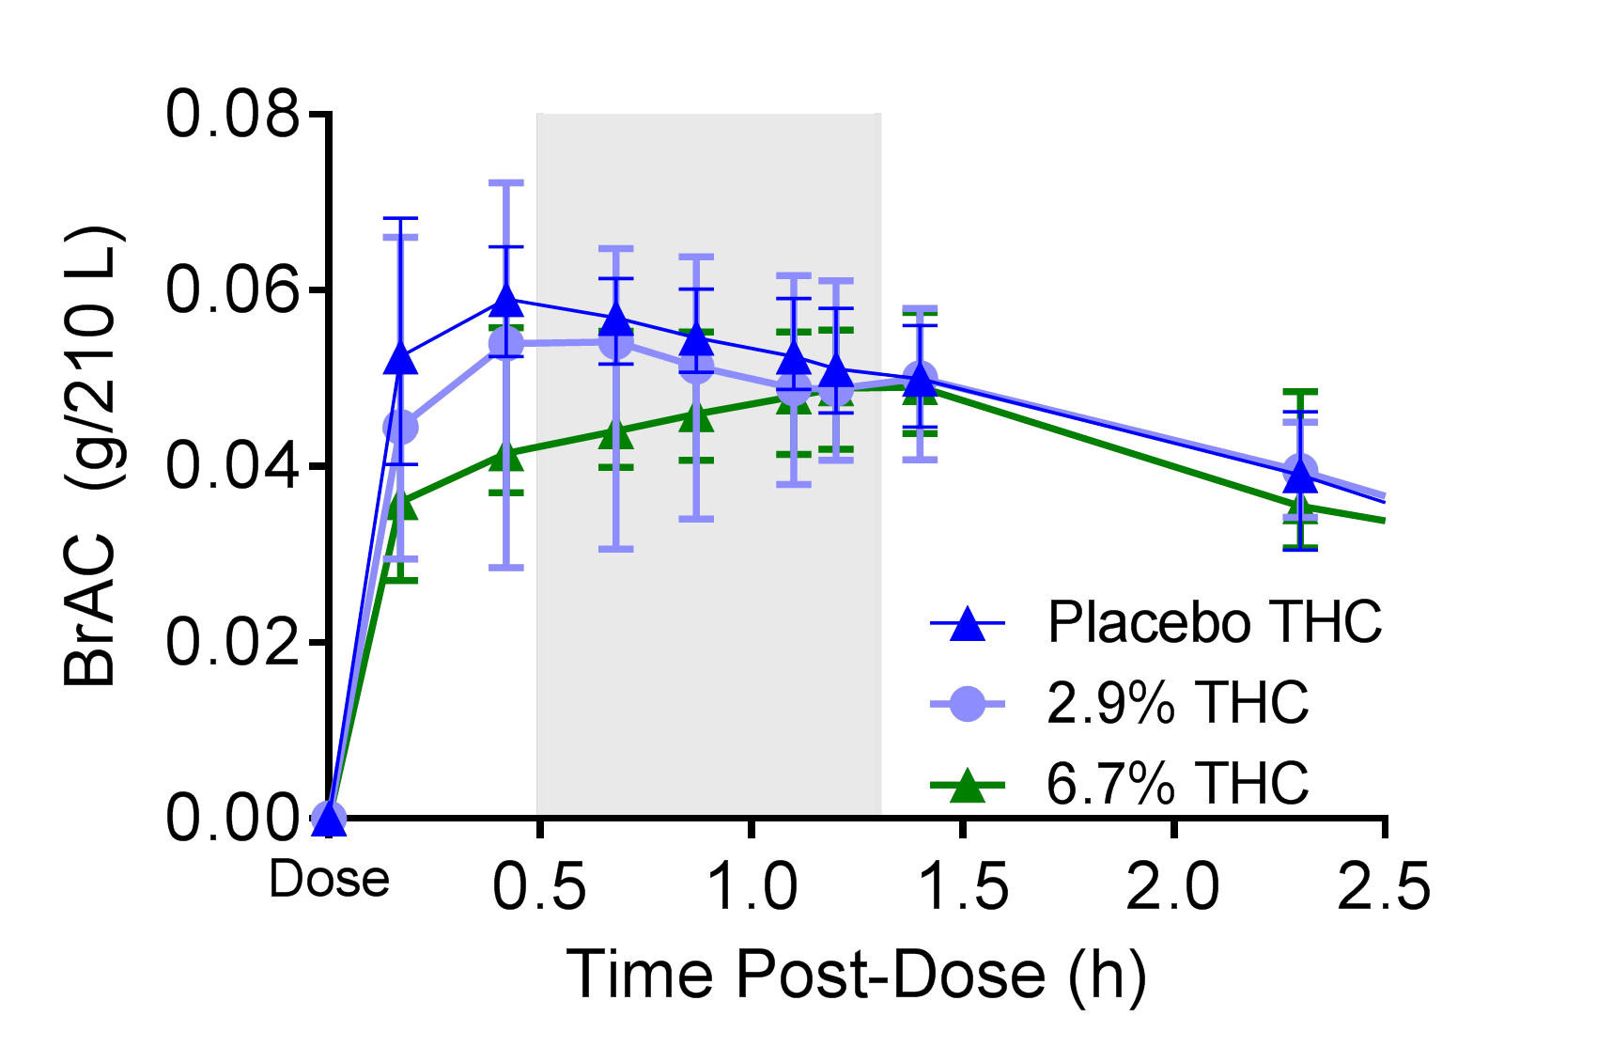
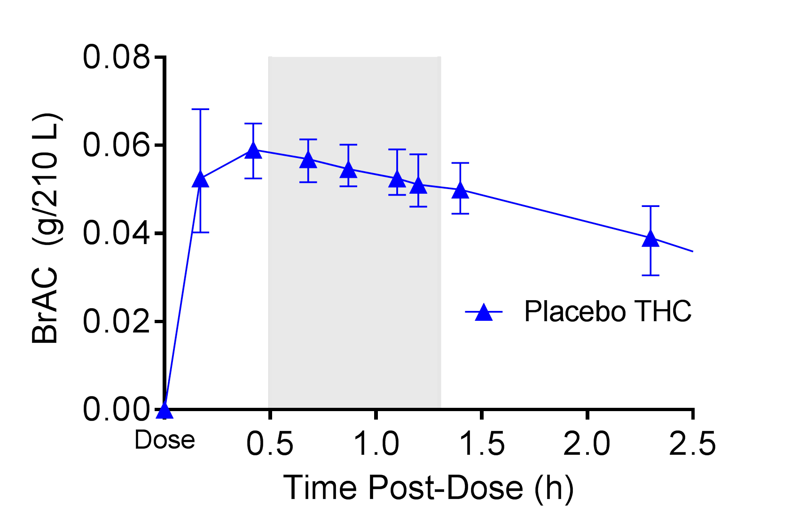
Median [Interquartile Range]
BrAC During Driving
Significantly later T_{max}
Drive
Notes:
Changed from Cmax to Tmax

Slide 14
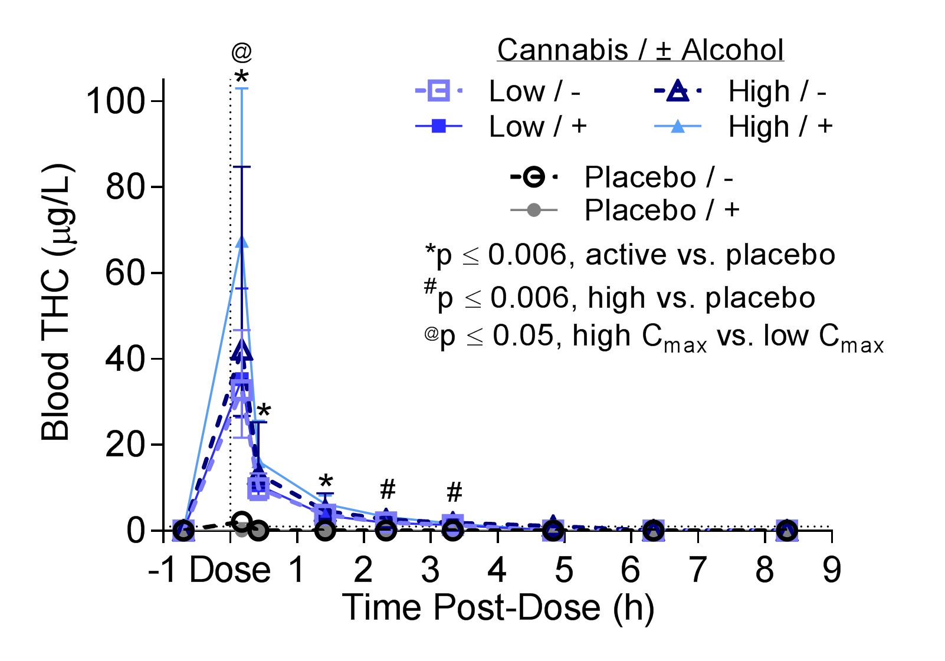
Median [Interquartile Range] Blood THC
Significantly greater C_{max} with alcohol

Slide 15
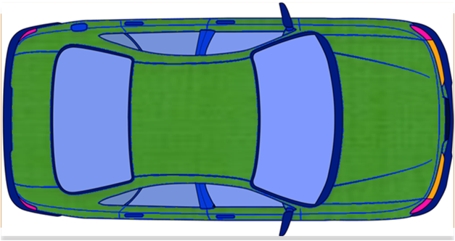

Cannabis & Alcohol Effects on Driving:
Lateral Control

Slide 16
SDLP vs. THC & SDLP vs. BrAC
8.2
13.1
Notes:
8.2 & 13.1 blood THC similar to 0.05 & 0.08 BrAC

Slide 17
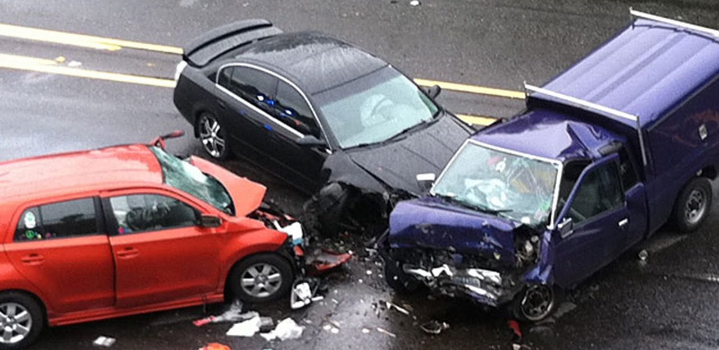

Slide 18
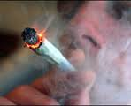
Effect of Collection Time on Blood THC Concentrations
Hartman et al 2016 Clinical Chemistry
  THC decreased median of 73.5% without alcohol & 75.1% with alcohol in 1st 30 min
  THC decreased median of 90.3% & 91.3% 1.4 h post-dose
  If delayed blood collection, THC may be lower than per se cutoffs despite greatly exceeding them during driving
  Concentrations during driving cannot be back-extrapolated due to unknown time after intake & inter-subject variability in rates of decrease

Slide 19
Cannabis & Alcohol Effects on Driving:
Longitudinal Control

Slide 20
National Advanced Driving Simulator, University of Iowa

Slide 21
Longitudinal Control Results
Measure | THC | BrAC | THC*BrAC
Mean Speed |  | -- | --
SD Speed | -- |  | --
% Speed High (>10% Above Limit) | -- |  | *
% Speed Low (>10% Below Limit) |  | -- | --
Longitudinal Acceleration | -- | -- | --
Following Distance |  | -- | --
Notes:
The measure is percent time.
% speed high and % speed low are % time spent >10% above or below the limit % speed high is % time speeding by more than 10% of the speed limit. 0 is case where no time was spent more than 10% above the limit.

Slide 22
THC, BrAC & Longitudinal Control
THC During Driving (µg/L) | BrAC During Driving (g/210 L) | ∆ Median Mean Speed (km/h) | ∆ Median SD Speed (km/h) | ∆ Median Percent Speed High (%) | ∆ Median Percent Speed Low (%) | ∆ Mean Following Distance (m)
0 | 0 | 0 | 0 | 0 | 0 | 0
1 | 0 | -0.2 | 0 | -- | 0.10 | 0.7
2 | 0 | -0.3 | 0 | -- | 0.21 | 1.3
5 | 0 | -0.9 | 0 | -- | 0.57 | 3.3
7 | 0 | -1.2 | 0 | -- | 0.86 | 4.7
10 | 0 | -1.7 | 0 | -- | 1.4 | 6.7
20 | 0 | -3.4 | 0 | -- | 4.0 | 13.3
0 | 0.02 | 0 | 0.17 | 0.17 | 0 | 0
0 | 0.05 | 0 | 0.42 | 0.60 | 0 | 0
0 | 0.08 | 0 | 0.67 | 1.4 | 0 | 0
0 | 0.10 | 0 | 0.83 | 2.2 | 0 | 0
5 | 0.05 | -- | -- | 0.37 | -- | --
17.8 | 0.05 | -- | -- | 0 | -- | --
20 | 0.05 | -- | -- | -0.04 | -- | --
Notes:
* Means this is the model that had the THC*BrAC interaction

Slide 23
But! What Are the Reasons for Cannabis & Driving Arrests?
2014 FARS data revealed that speeding occurs in 35.8% of all fatal cannabis driving cases compared to 25.9% of cases with no-alcohol or drugs cases (Crancer & Drum, The Mercury News, April 2016)
Courtesy of Chuck Hayes, IACP

Slide 24
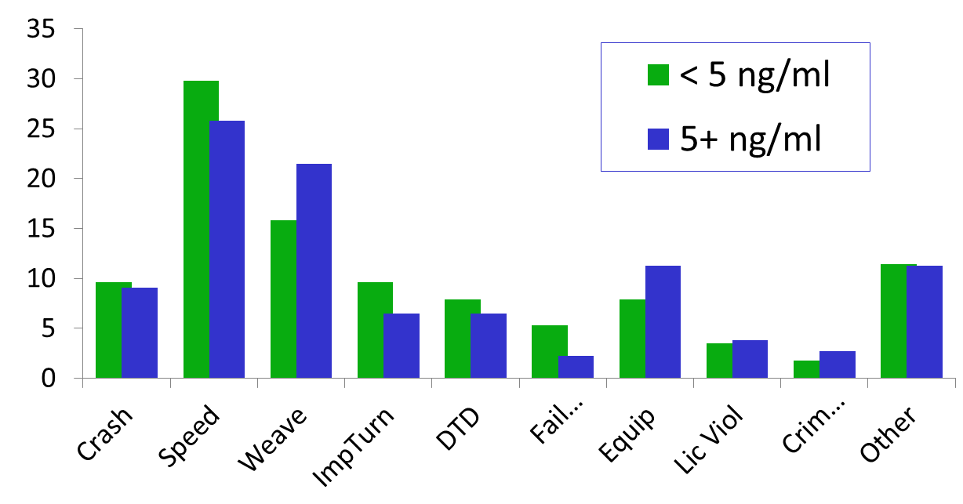
Reasons for Traffic Stop?
Courtesy of Chuck Hayes, IACP

Slide 25
Acute Cannabinoid Pharmacokinetics in Occasional Cannabis Users

Slide 26
THC, 11-OH-THC & THCCOOH Plasma Concentrations After Smoking Cannabis
180
3.55% THC
150
THC
11-OH THC
THCCOOH
THC
120
Inhale
µg/L
N = 6
90
  THC detected 3 - 27 h THCCOOH 2 – 7 days
  LOQ 0.5 µg/L
60
30
Huestis et al
J Anal Toxicol 1992
0
-2
2
6
10
14
18
22
Minutes

Slide 27
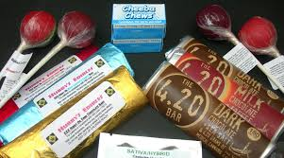
Occasional Smokers’ Blood Cannabinoids Concentrations After
Smoked, Vaporized & Oral (Edible) Cannabis
Chronic Daily Cannabis Smokers
After Acute Exposure

Slide 28
Mean Blood THC Concentrations in Occasional Smokers After 50.6 mg THC by 3 Administration Routes
N=9, LOQ=0.5
µ

Slide 29
Mean Blood 11-OH-THC in Occasional Smokers After 50.6 mg THC by 3 Administration Routes
N=9, LOQ=0.5 µg/L
µ

Slide 30
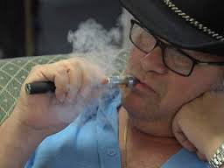
Residual Blood Cannabinoids Excretion in Chronic Frequent Cannabis Smokers Over 30 Days Sustained Abstinence

Slide 31
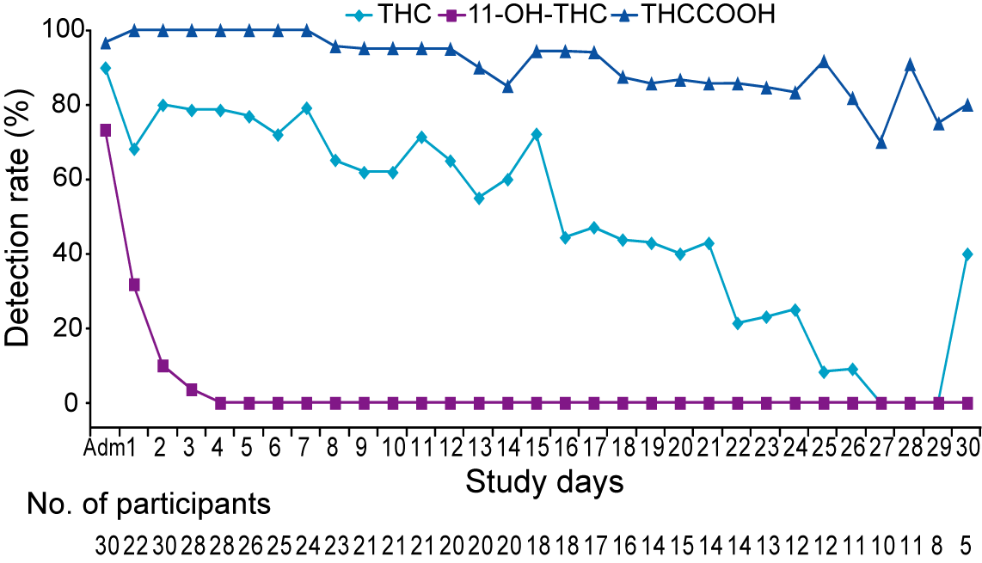
Blood Detection Rates for THC, 11-OH-THC & THCCOOH in Chronic Frequent Cannabis Smokers Over 30 Days Sustained Abstinence
LOQ 0.5 µg/L

Slide 32
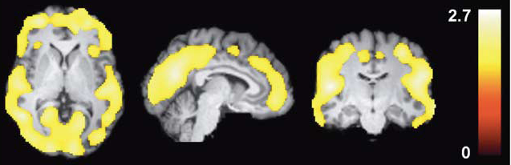
[¹⁸F]FMPEP-d₂ Labels CB1 Cannabinoid Receptors in Brain of Chronic Daily Cannabis Smokers

Slide 33
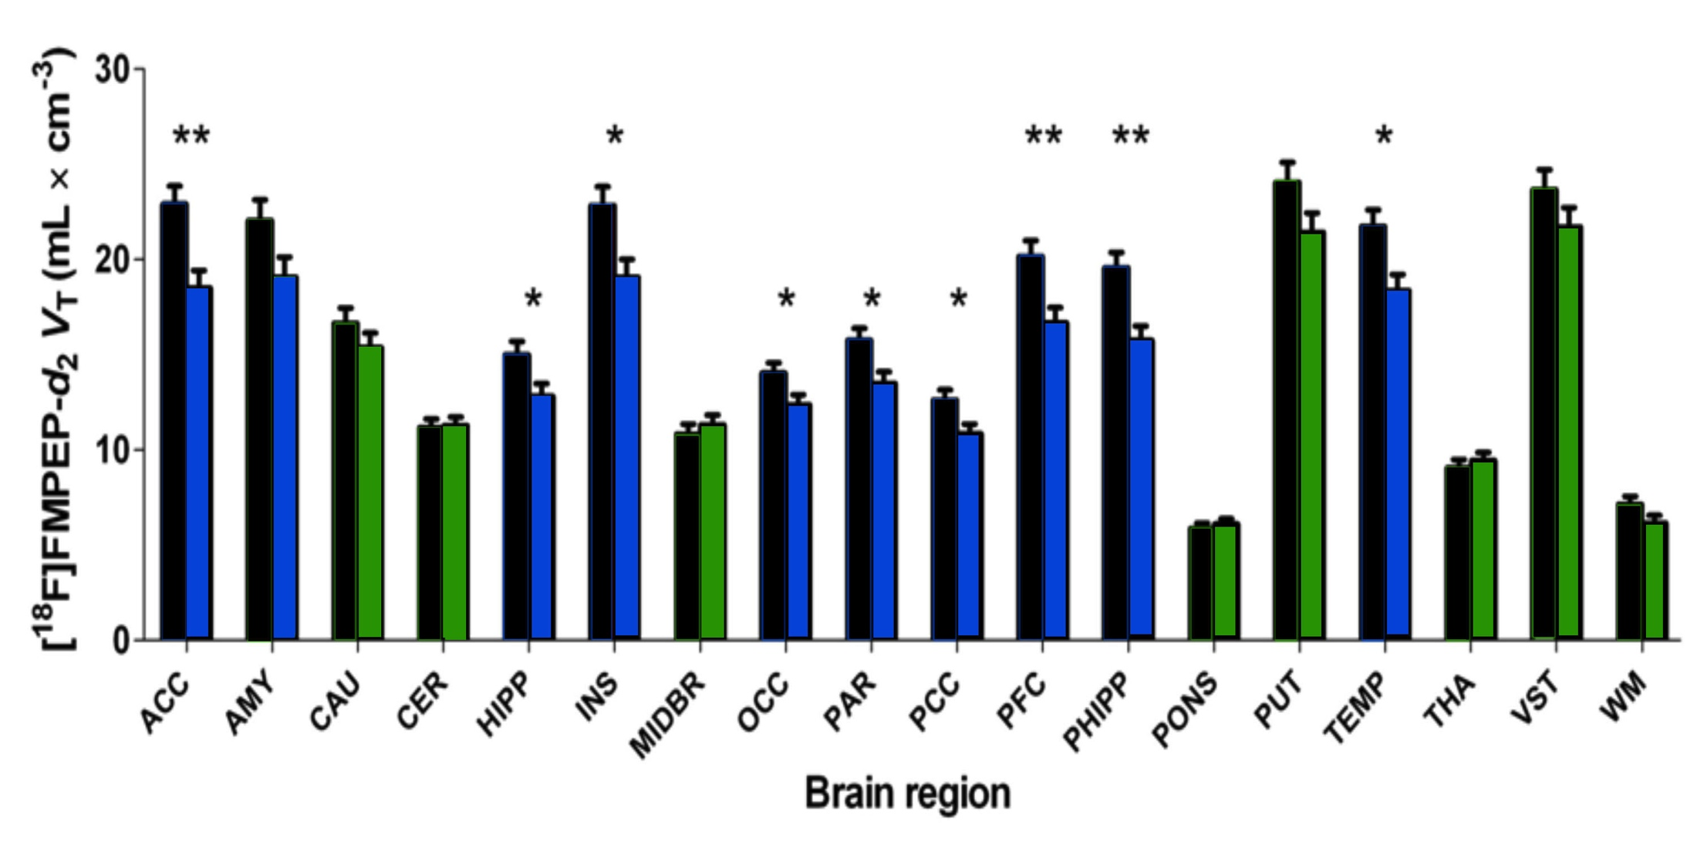
CB₁-Cannabinoid Receptors Specifically Downregulated in Cortical Regions
of Chronic Daily Cannabis Smokers (N=30)
as Compared to Controls (N=28)
*
*
Notes:
Blue are control VT that are significantly decreased with chronic cannabis smoking.
Green show areas of brain that were not significantly decreased.

Slide 34
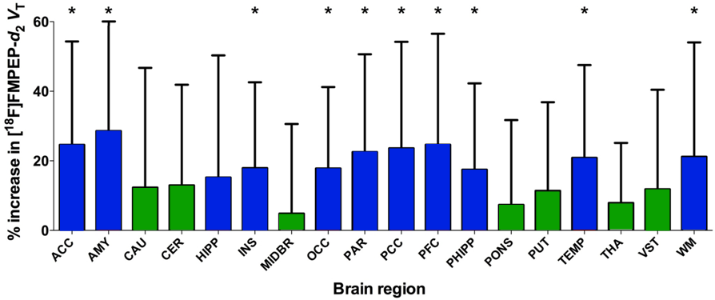
CB₁ Cannabinoid Receptors Significantly Increased after Sustained Cannabis Abstinence (N=14)

Slide 35
Residual Psychomotor Impairment in Chronic Frequent Cannabis Smokers During Sustained Abstinence
PLOS One 2012

Slide 36
Psychomotor Impairment in Chronic Daily Cannabis Smokers
What is duration of psychomotor impairment in chronic daily cannabis smokers?
Compared psychomotor performance on tasks validated by Jan Ramaekers at University of Maastricht to predict impaired
on the road driving
Compared performance of chronic frequent smokers to occasional cannabis & ecstasy users over 22 days

Slide 37
Mean ± SE Tracking Error (mm) in
Chronic Daily Cannabis Smokers During Sustained Abstinence
*
#
*
#
*
*

Slide 38
Mean ± SE DAT Control Losses in
Chronic Cannabis Smokers During
Sustained Cannabis Abstinence
*
*
#
*
*
Notes:
# Significantly different to baseline
* Significantly different to control

Slide 39
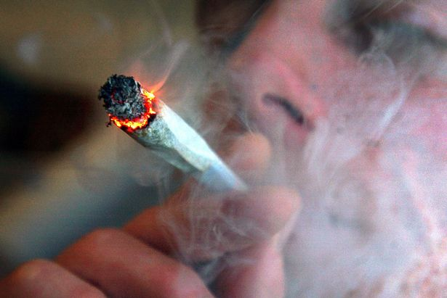
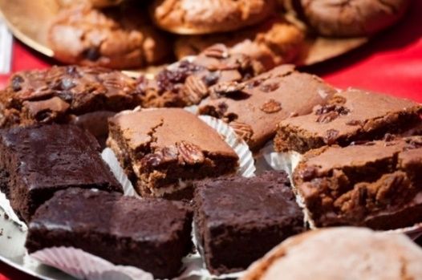
Are There Other Blood Cannabinoid Markers of Recent Cannabinoid Intake?

Slide 40
Monitoring Cannabinoid Concentrations
Identifying recent cannabis intake in blood
Chronic frequent cannabis smoker 6 min into 10 min vaporization ~50 mg THC
THCCOOH, 89.8 µg/L
THCCOOH-gluc,
221 µg/L
THC
78.0 µg/L
11-OH-THC
4.6 µg/L
CBN
6.4 µg/L
CBG
2.3 µg/L
THCV-
COOH,
1.2 µg/L
CBD
2.0 µg/L
Notes:
So switching gears a little bit, I want to talk briefly about how we test for marijuana use. Testing also affected by BMI

Slide 41
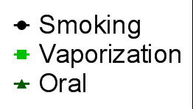
N = 11
µg/L

Slide 42
Recent Cannabis Intake Markers
Analytes not useful recent use markers due to long detection time: THCVCOOH
Analytes maybe useful recent use markers but low detectability: THCV, THC-glucuronide
Analytes with high detectability & short windows of detection: CBD, CBG, CBN
  May not be seen after oral dosing
  Minor cannabinoids inclusionary, but not exclusionary markers of intake
  With new CBD rich cannabis strains, CBD can’t be used as a marker of recent use until evaluated

Slide 43
Is There A Correlation
Between THC Blood Concentration
& Driving Impairment?

Slide 44
Blood THC Distribution in DRE Cases
120
100
s
80
e
s
a
60
C
40
20
0
.
9
9
9
9
9
5
1
4
.
.
.
.
2
-
-
-
9
1
4
2
4
≥
0
0
0
-
-
1
.
.
.
0
0
2
5
.
.
1
0
1
5
Blood THC (µg/L)

Slide 45
Walk And Turn Clues & Observations
Clues
Observations
)
60
%
Cases
Controls
(
s
e
45
s
a
C
f
30
o
t
n
e
c
15
r
e
P
0
o
n
c
e
o
p
s
o
e
i
n
e
c
e
p
s
r
n
o
r
s
S
o
a
n
t
-
T
L
a
n
t
e
T
u
m
l
S
l
f
l
S
o
o
B
a
e
e
o
f
B
a
#
e
r
r
e
s
t
e
s
H
p
s
t
o
c
t
o
p
T
r
t
o
s
e
s
t
e
s
r
e
p
r
S
t
a
L
i
s
s
S
r
m
c
o
r
I
m
M
A
I
n

Slide 46
Number of WAT Clues
≥2 considered “Impaired”
)
100
Median = 0
%
(
Cases
Controls
s
80
e
s
p<0.001
a
C
60
f
p>0.05, THC ≥5 vs. <5 µg/L
o
t
40
n
e
Median = 3
c
r
20
e
P
0
0
1
2
3
4
5
6
7
8
Number of Clues

Slide 47
Determining Most Reliable Drug Evaluation & Classification Program Metrics for Identifying Cannabis Impairment in Drivers

Slide 48
Optimizing Combined Cannabis Performance Characteristics
Sign/ Observation/ Condition | 2/4 of: ≥3 Misses FTN; Eyelid Tremors MRB; ≥2 Clues OLS; ≥2 Clues, WAT | ≥2 Clues OLS or ≥2 Clues, WAT | Rebound Dilation or LOC
% Cases | 97.0 | 87.1 | 92.7
% Controls | 3.3 | 3.0 | 10.9
Sensitivity (%) | 97.0 | 87.1 | 92.7
Specificity (%) | 96.7 | 97.0 | 89.1
PPV (%) | 96.7 | 96.7 | 89.5
NPV (%) | 97.0 | 88.3 | 92.4
Efficiency (%) | 96.9 | 92.1 | 90.9

Slide 49
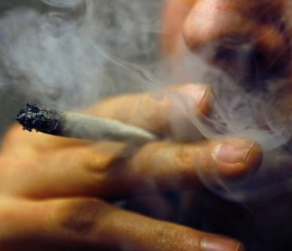
What About Tolerance to THC with Chronic Frequent Cannabis Intake?

Slide 50
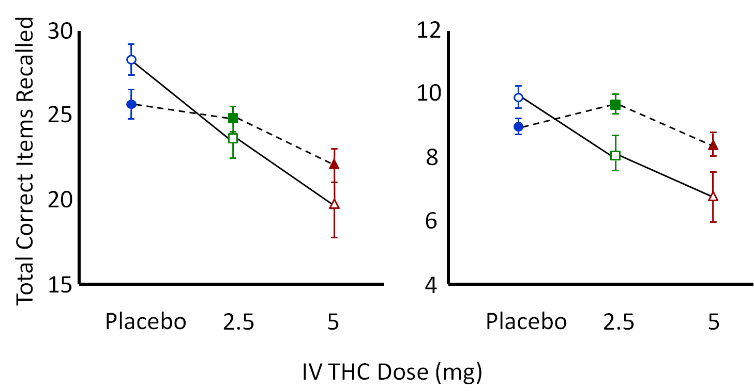
Dose & Tolerance Effects
Total Immediate Recall
Delayed Free Recall
Total Correct Items Recalled
Placebo Nonabuser
2.5 mg Nonabuser
5 mg Nonabuser
Placebo Abuser
2.5 mg Abuser
5 mg Abuser
D’Souza, Neuropsychopharmacology, 2008
Notes:
This is the slide with the saved picture pasted in. This can be re-scaled as you wish. (I did re-scale it slightly.) This is the slide you want for your presentation.
Same study as Morrison et al
2.5 and 5 mg IV THC to non-abuser and THC abusers (30 frequent users, 22 controls/non-users)
Learning and Recall (Hopkins Verbal Learning Task)
Immediate and Delayed verbal recall measured by the Hopkins Verbal Learning Task (T bars indicate SEMs). Immediate recall: frequent users performed worse at baseline, but had smaller Δ-9-THC-induced impairments than controls. Delayed recall: Δ-9-THC impaired delayed recall in both groups. Only in frequent users, recall was worse on placebo than the low dose.
Current frequent users were defined as having 1) a positive urine toxicological test for cannabis at screening, and 2) at least 10 exposures to cannabis within the past month as quantified by a time line follow back approach (Sobell & Sobell 1992). These subjects also met criteria for current DSM-IV cannabis abuse disorder while none of the controls did. Controls were required to have 1) a negative urine toxicological test at screening, 2) no exposure to cannabis in the past week and 3) no more than 1 exposure to cannabis in the past month.

Slide 51
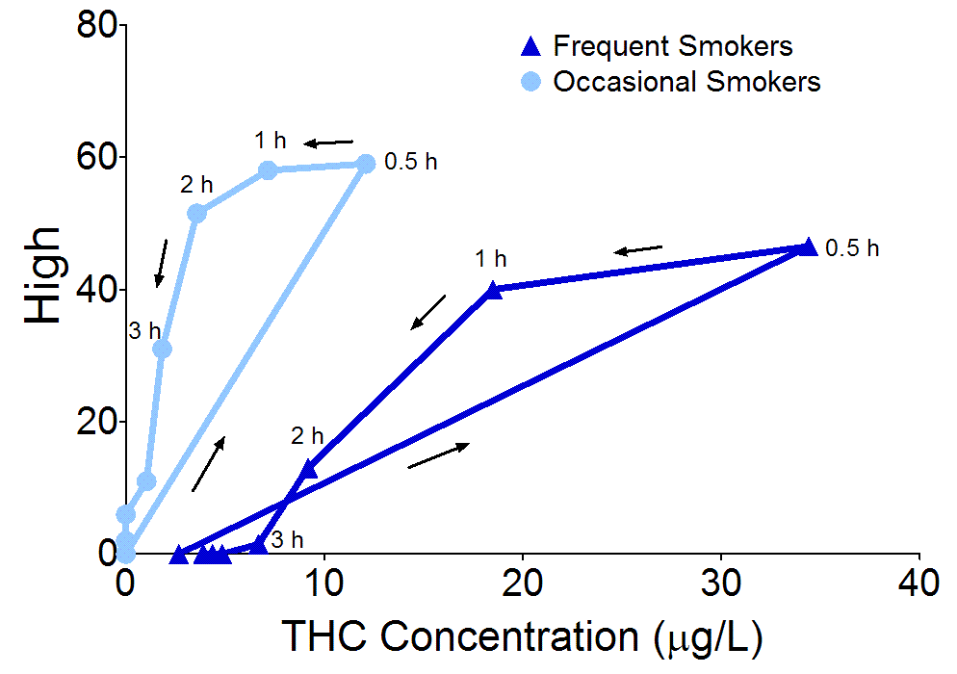
Tolerance in Subjective “High”
Notes:
This graph shows hysteresis, a phenomenon in which stronger effects occur during distribution or elimination phase of the time-concentration curve than during absorption or the upward slope, even at the same THC concentrations.
- You can see that frequent smokers’ hysteresis curve was displaced to the right, because they had higher concentrations and lower subjective effects compared to occasional smokers.

Slide 52
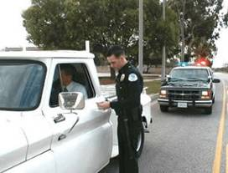
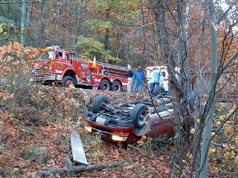
Is There A THC Blood Concentration That Indicates Driving Impairment?
1, 2 or 5 µg/L?

Slide 53
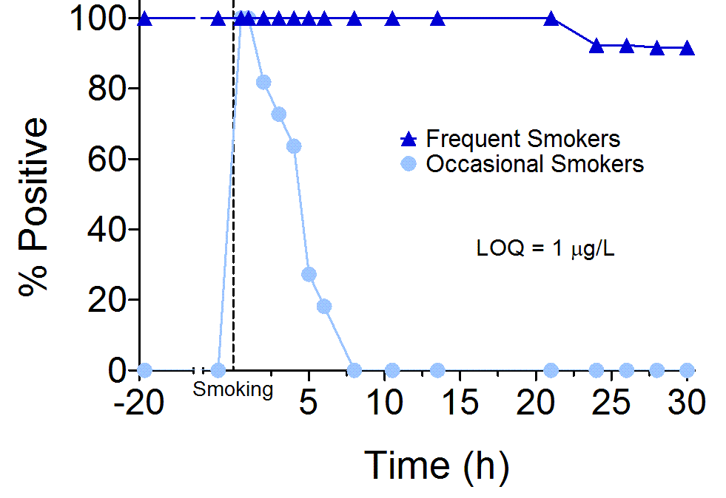
Blood THC After Smoking 6.8% THC Cigarette
LOQ 1 µg/L
Desrosiers Clin Chem 2014

Slide 54
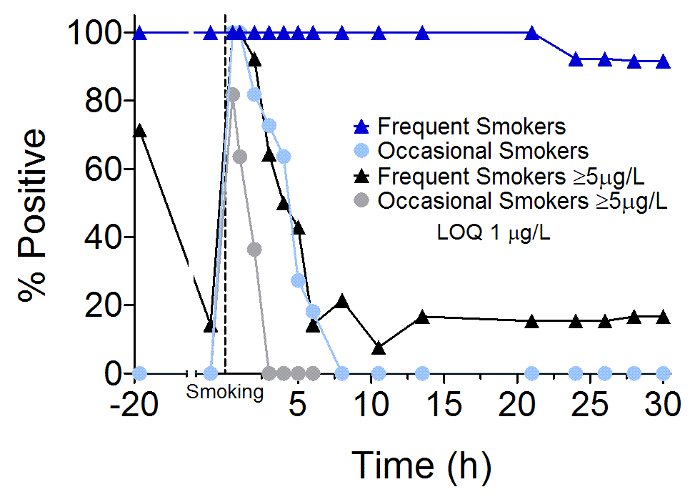
Blood THC After Smoking 6.8% THC Cigarette

Slide 55
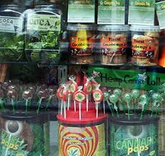
Public Misconceptions about Cannabis
Cannabis is not addictive
Cannabis does not affect cognitive
or psychomotor performance
Cannabis use during pregnancy does not harm the fetus & the developing child
Cannabis must be safe if it is medicine
CBD prevents seizures in Dravet’s syndrome
Tolerance to all cannabis effects occurs with chronic frequent use
Notes:
Lack clinical studies

Slide 56
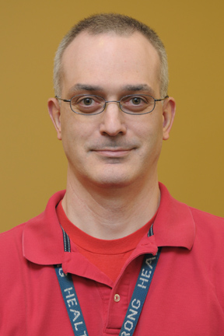







Karl
Scheidweiler, PhD
Allan
Barnes, BS
Natalie Desrosier, PhD
Rebecca
Hartman, PhD
Osama Abulseoud, MD
Erin
Karschner, PhD
David
Schwope, PhD
Mateus Bergamaschi,
PhD
Matt
Newmeyer, PhD
Xingxing
Diao, PhD
Maria
Andersson, PhD
Jeremy
Charlier, PhD

Slide 57

Thank you for your attention!
Cristina
Sempio, MS
Megan
Taylor, BS
Caitlin
House, BS

