Slide 1
What should the role of enforcement be in drug control?
Kevin A. Sabet, Ph.D.
SAM Director & Co-Founder
Director, Drug Policy Institute, University of Florida
President, Policy Solutions Lab

Slide 4
Enforcement’s primary role should be to
protect public safety
Can do this through keeping prices of illegal drugs high
also
Deterrence through swiftness, certainty, and celerity

Slide 5
Fully legal production and supply far cheaper than illegal wholesale prices (Caulkins)
Sources: Altered State? (RAND 2010), interview with medical marijuana cultivator, Kilmer (2012)
Notes:
WE KNOW THIS IS POSSIBLE FROM THE GREY LITERATURE
PRICE COULD FEASIBLY DROP EVEN MORE IF EFFICIENCY AND SCALE ARE MAXIMIZED BEYOND WHAT IS KNOWN POSSIBLE TODAY

Slide 6
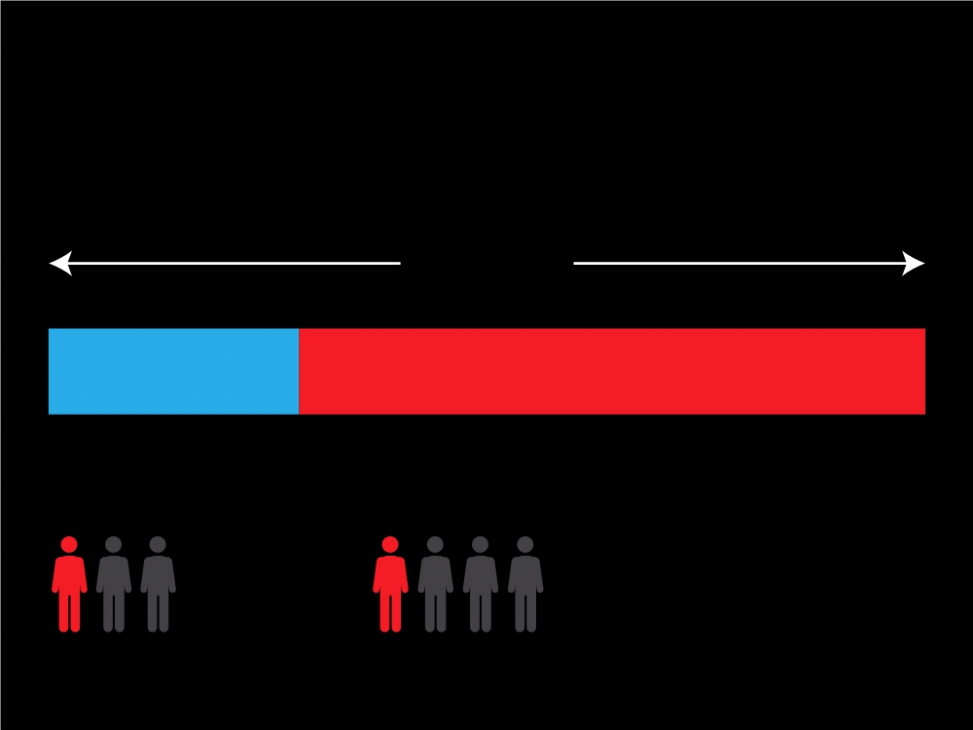
Enforcement:
An untapped opportunity for progress
7 million
Americans in the Criminal Justice System
2 million
5 million
Incarcerated
On Probation or Parole
Nearly a
… and a quarter of Federal
third of State
prisoners committed their crimes
prisoners …
under the influence of drugs

Slide 7
Standard Community Corrections Programs
Probationers must comply with certain conditions
Due to heavy caseloads, probationers are not monitored strictly
Drug testing is infrequent
It is difficult and time-consuming to enforce sanctions or revoke probation or parole
Sanction rates are low and sporadic

Slide 8
Problems with the Current System
Criminals are often impulsive and do not consider long-term consequences
By rarely enforcing sanctions, probationers learn they can violate terms, often without consequence
Drug treatment program completion rates are low
Many probationers need housing, job training, and healthcare

Slide 9
Emerging Community Corrections Programs
New community corrections programs show more promise than the typical model
These programs help break the arrest, incarceration, release, and re-arrest cycle
The strategies use swift and certain – but modest – sanctions for drug use or re-offending
Evidence to-date has been positive

Slide 10
Drug Courts
Started in Miami in 1989, there are now over 1,600 throughout the United States
Non-violent offenders charged with drug crimes are eligible
Programs differ among jurisdictions, with some similarities:
Duration is approximately one year
Drug tests and outpatient treatment are required
Weekly court meetings
Defendants must obtain a GED and employment
Separate drug courts exist for juveniles

Slide 11
Drug Courts
Drug courts have been successful in reducing drug use and recidivism, particularly for graduates
Jail space is saved
They are cost effective due to:
Reduced recidivism
Reduced costs related to victimization
Healthcare costs

Slide 12
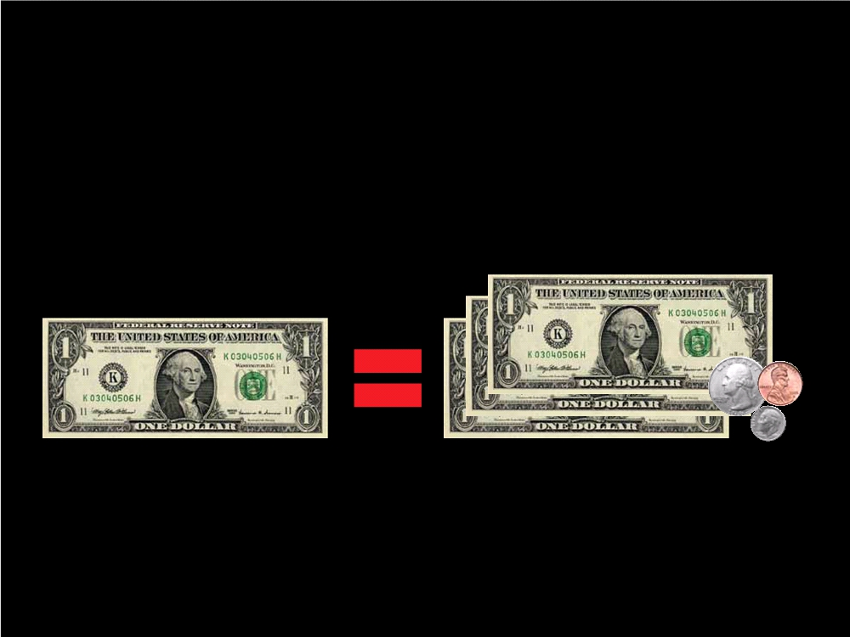
Enforcement and Treatment Can Work Together
For every $1.00 invested in Drug Court, taxpayers save as much as $3.36 in avoided criminal justice costs alone.

Slide 13
Hawaii HOPE
Began in 2004 on Oahu
Probationers are subject to frequent, random drug testing
Every positive drug test leads to an immediate, short-term jail stay
Drug treatment may be requested at any time, but is required for repeated failures – a process known as “behavioral triage”

Slide 14
Hawaii HOPE
HOPE probationers have significantly reduced rates of drug use
Participants speak highly of the program and appreciate its consistency
Judges and probation officers are very satisfied with the program
It is cost-effective, with the majority of the cost going toward treatment for intensive drug users

Slide 15
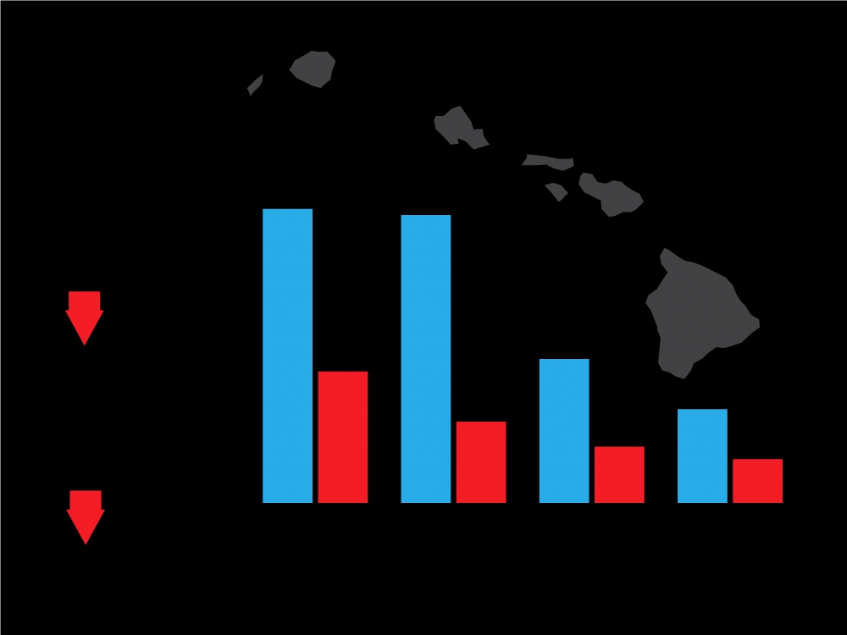
Project Hope
Reduction in missed
47%
46%
Project Hope
Control
appointments
85%
21%
23%
Reduction
13%
15%
in positive urinalyses
9%
7%
91%
Arrested Used Drugs
Skipped Probation Appointments Revoked

Slide 16
South Dakota 24/7 Sobriety
Operates across the state
DUI offenders must undergo twice-daily alcohol breath testing and random drug testing
Some offenders wear an alcohol-monitoring ankle bracelet or drug-testing patch
Participants who fail a breathalyzer or drug test are immediately sent to jail for a short period

Slide 17
South Dakota 24/7 Sobriety
24/7 has significantly reduced the number of DUIs
Rates of offenses for program participants were significantly lower during the first 30 days of the program, and even lower after 90 days

Slide 18
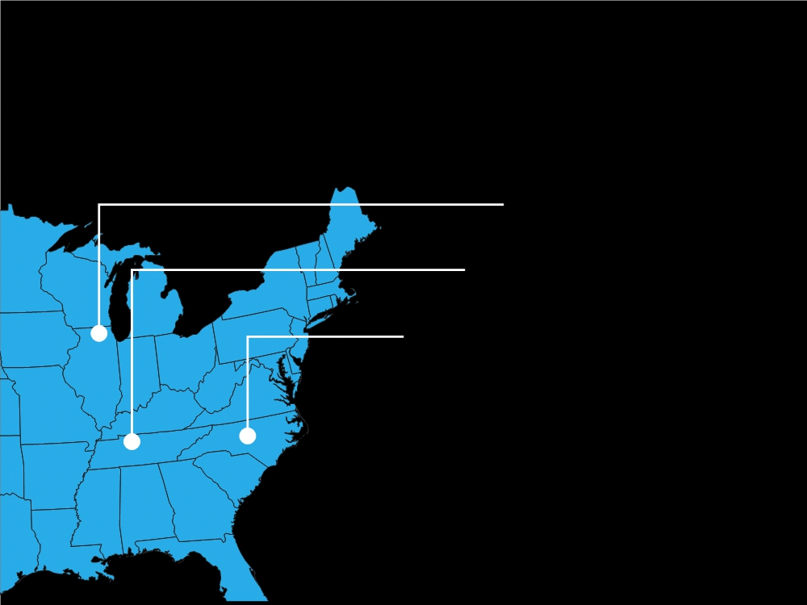
Drug Market Interventions (DMI)
In Rockford, Illinois, property
crime declined by 24 percent.
In Nashville, Tennessee, drug crime declined by 39.5 percent.
In High Point, North Carolina, the first site, indicated that the target area experienced a substantial decline in violent (30.6%) and drug-related crime (32.2%).
In all three communities, interviews with local
residents revealed a perceived decline in crime and disorder, reported improvement in the quality of neighborhood life, and appreciation for the police.

Slide 19
Re-entry

Slide 20
Texas Case Study
Should we spend $523 Million on constructing a new prison?
First, commissioned study on how to reduce population: study showed that if $240 million were spent on substance abuse treatment, prison population would decline.

Slide 21
Texas Case Study
Legislature then implemented study findings, which saved the state over $210 million for the 2008-2009 fiscal. year.
Also established permanent monitoring system to ensure continued successful reduction in prison population.

Slide 22
Texas Case Study
Legislature then implemented study findings, which saved the state over $210 million for the 2008-2009 fiscal. year.
Also established permanent monitoring system to ensure continued successful reduction in prison population.

Slide 23
There are many ways to reduce incarceration and other related consequences without legalizing drugs.

Slide 24
Challenges
Programs must start slowly
Inconsistency may lower effectiveness
The programs reach a small percentage of the overall criminal caseload
Treatment must be available if needed or requested

Slide 25
Challenges
“It’s very easy to change criminal behavior, but very difficult to change judge behavior…”

Slide 26
Solutions
Intervention
& Treatment
Smart
International
Prevention
Recovery
Enforcement
Efforts

Slide 27
References
Bulman, P. (2010). In brief: Hawaii HOPE. National Institute of Justice: Washington, DC.
Carns, T. W., & Martin, S. (2011). Anchorage PACE: Probation accountability with certain enforcement: A preliminary evaluation of the Anchorage pilot PACE project. Alaska Judicial Council: Anchorage, AK.
Cooper, C. S. (2003). Drug courts: Current issues and future perspectives. Substance Use and Misuse:38(11-13):1671-1711.
DuPont, R. L. (2009). HOPE probation: A model that can be implemented at every level of government. Institute for Behavior and Health: Rockville, MD.
DuPont, R. L. (2010). Is 24/7 sobriety a good goal for repeat driving under the influence (DUI) offenders? Addiction;105:575-577.
Fox, A., & Gold, E. (2011). Small experiments, big change: HOPE probation and the use of demonstration projects to advance criminal justice reform. Center for Court Innovation: New York.
Hawken, A. (2010). HOPE for probation: How Hawaii improved behavior with high-probability, low-severity sanctions. The Journal of Global Drug Policy and Practice, 4(3).
Hawken, A., & Kleiman, M. (2009). Managing drug involved probationers with swift and certain sanctions: Evaluating Hawaii’s HOPE. National Institute of Justice: Washington, DC.
Hawken, A., & Kleiman, M. (2011). Washington intensive supervision program: Evaluation report (DRAFT). City of Seattle: Seattle, WA.
Henggeler, S. W. (2007). Juvenile drug courts: Emerging outcomes and key research issues. Current Opinion in Psychiatry;20:242-246.
HOPE Probation (2012). See http://www.hopeprobation.org/about/program-evaluation-results. Accessed January 10, 2012.
King, R. S., & Pasquarella, J. (2009). Drug courts: A review of the evidence. The Sentencing Project: Washington, DC.
Kleiman, M. A. (2011). Justice reinvestment in community supervision. Criminology and Public Policy, 10(3):651-659.

Slide 28
References
Kleiman, M. A., & Hawken, A. (2008). Fixing the parole system. Issues in Science and Technology, Summer 2008, 45-52.
Loudenburg, R., Drube, G., & Leaonardson, G. (2011). South Dakota 24/7 sobriety program evaluation findings report. Mountain Plains Evaluation: Salem, SD.
National Institute of Justice. (2010). In Brief: Hawaii Hope. NIJ Journal No. 266, June 2010
O’Connell, D., Visher, C. A., Martin, S., Parker, L., & Brent, J. (2011). Decide your time: Testing deterrence theory’s certainty and celerity effects on substance-using probationers. Journal of Criminal Justice;39:261-267.
Office of Justice Programs (2011). Fiscal Year 2011 Grant Awards. Accessed January 2, 2011, from http://www.ojp.usdoj.gov/funding/11grantawards.htm
Wenzel, S. L., Longshore, D., Turner, S., & Ridgely, M. S. (2001). Drug courts: A bridge between criminal justice and health services. Journal of Criminal Justice;29:241-253.

Slide 29
Thank You!
Questions?
www.kevinsabet.com
www.learnaboutsam.org
Email
info@learnaboutsam.org
kevin@learnaboutsam.org

