Slide 1
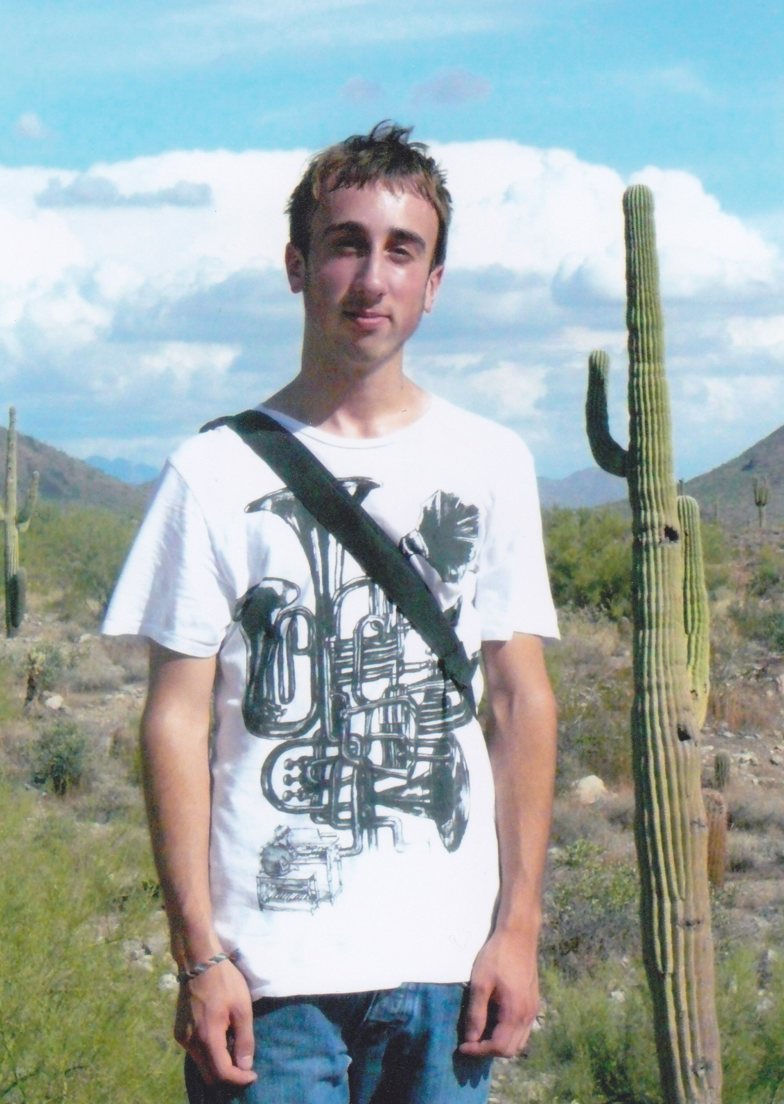

Slide 2
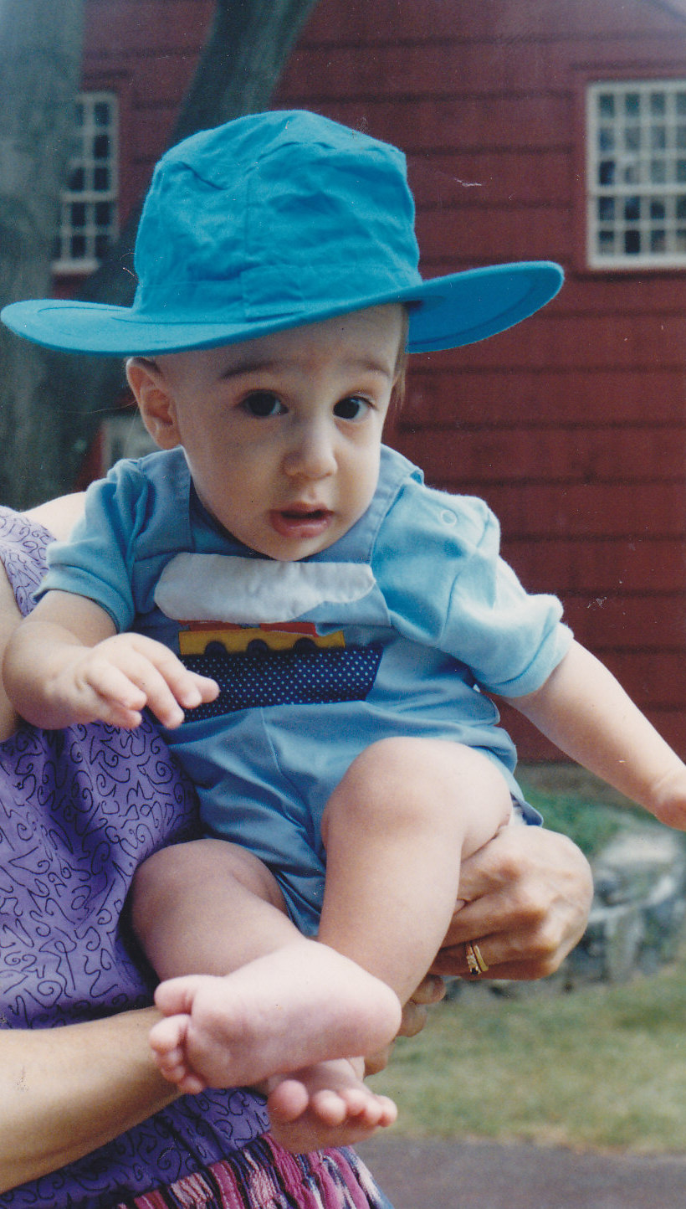

Slide 3
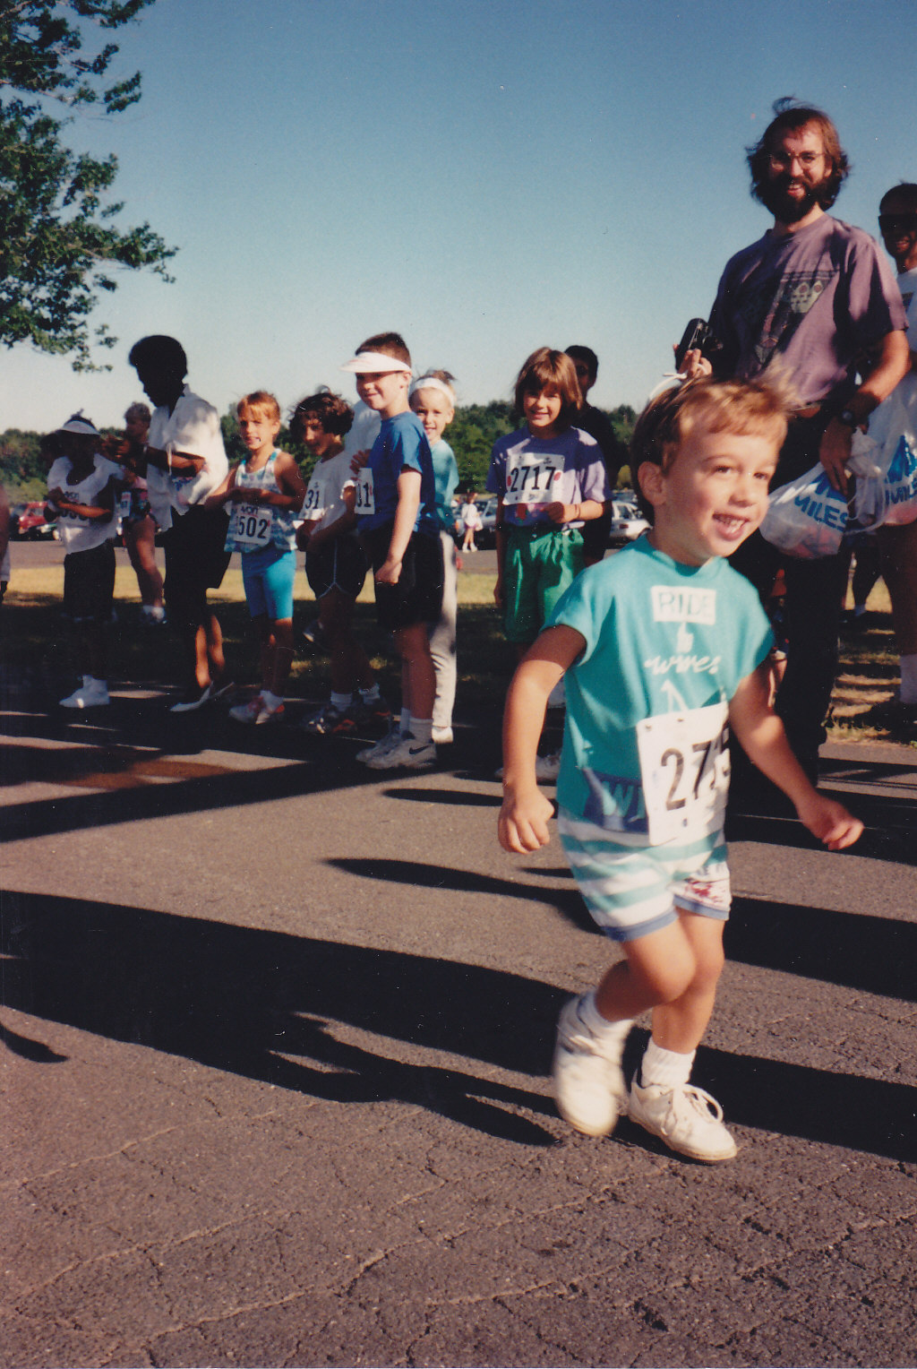

Slide 4
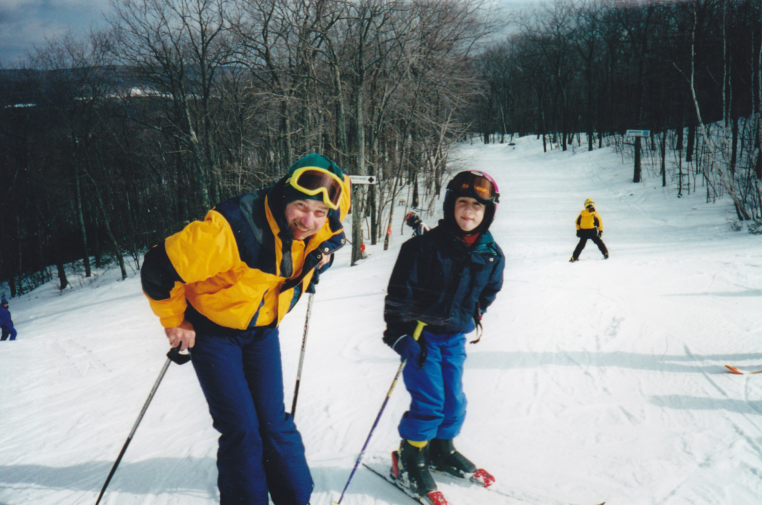
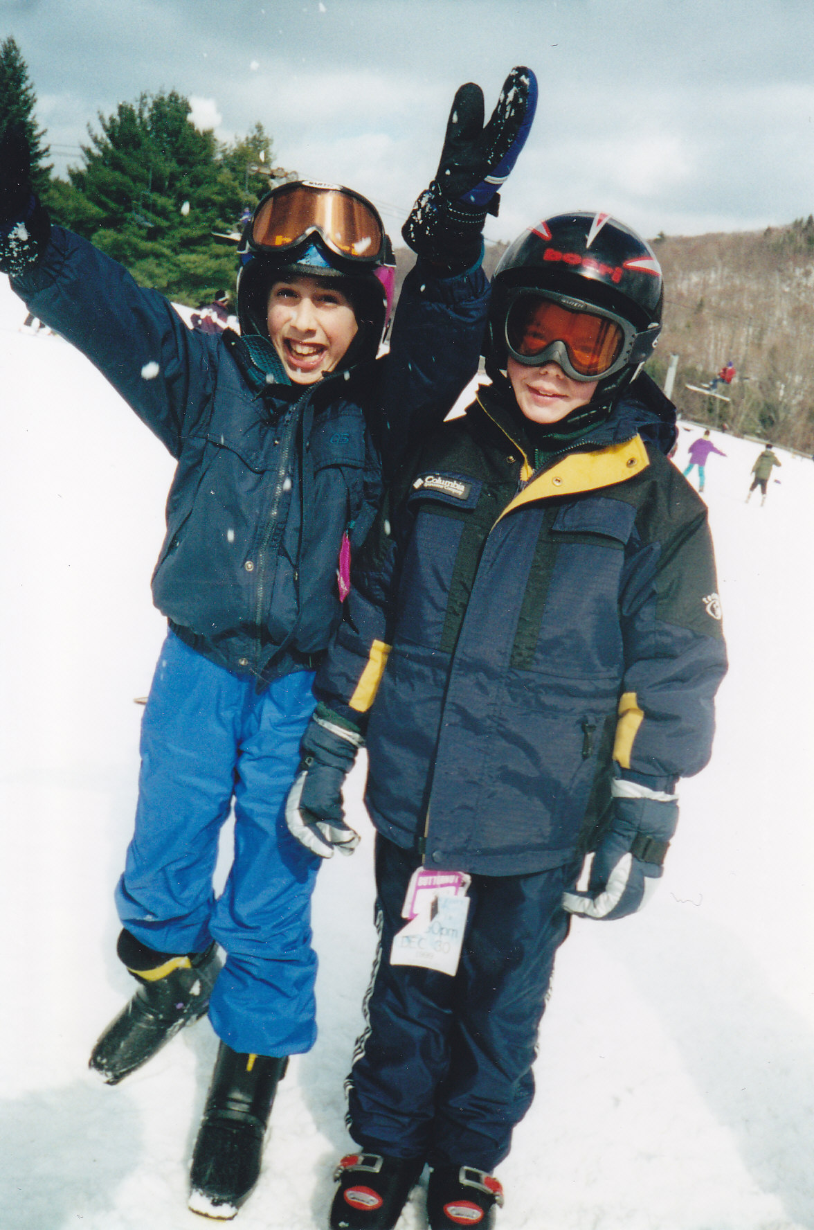

Slide 5
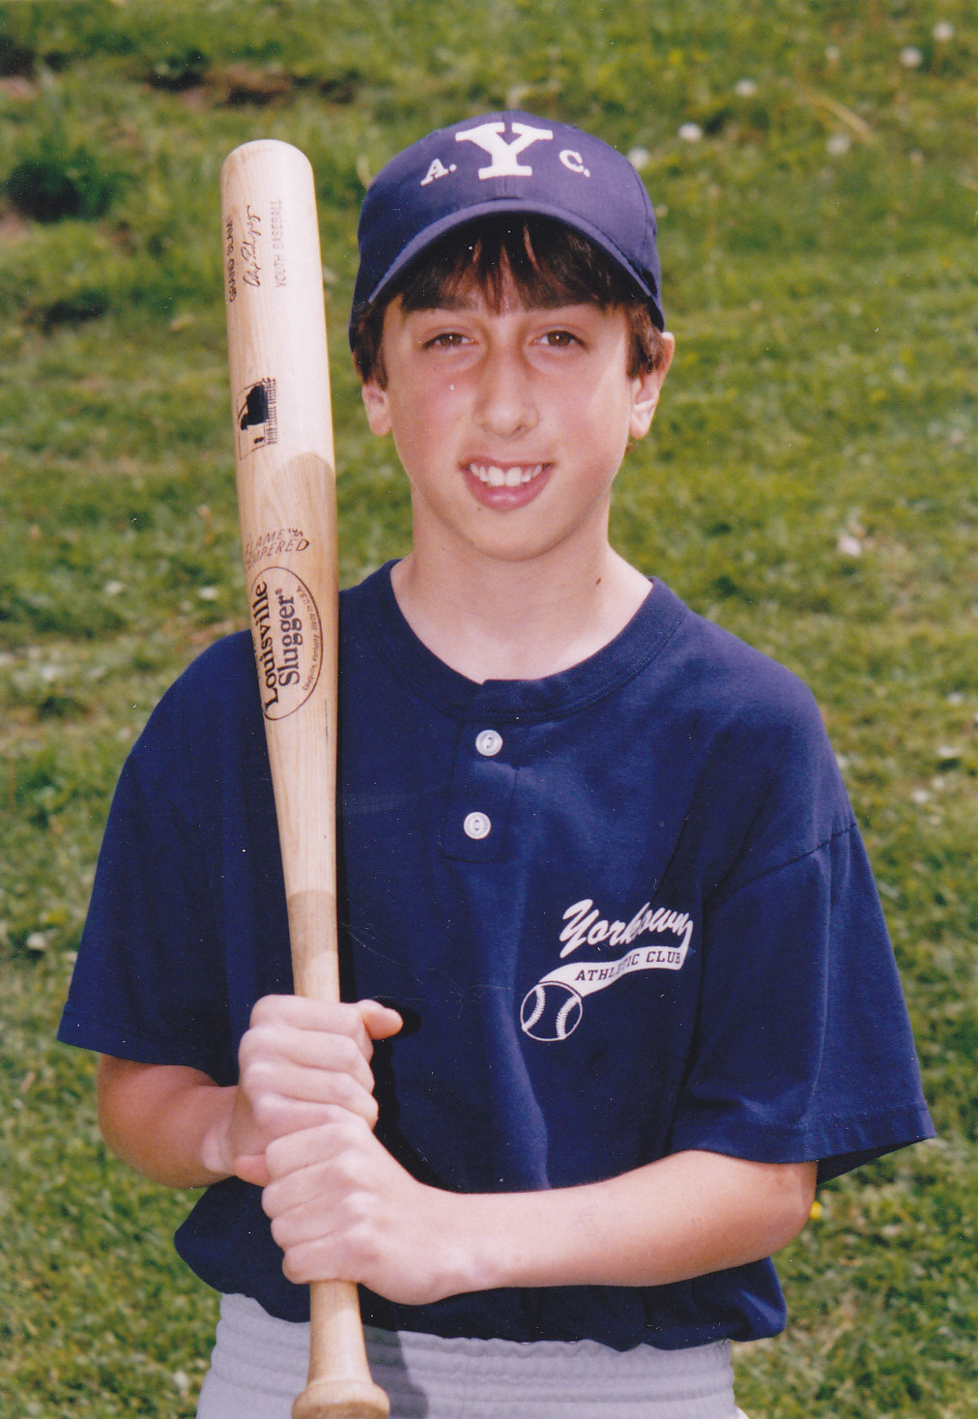

Slide 6
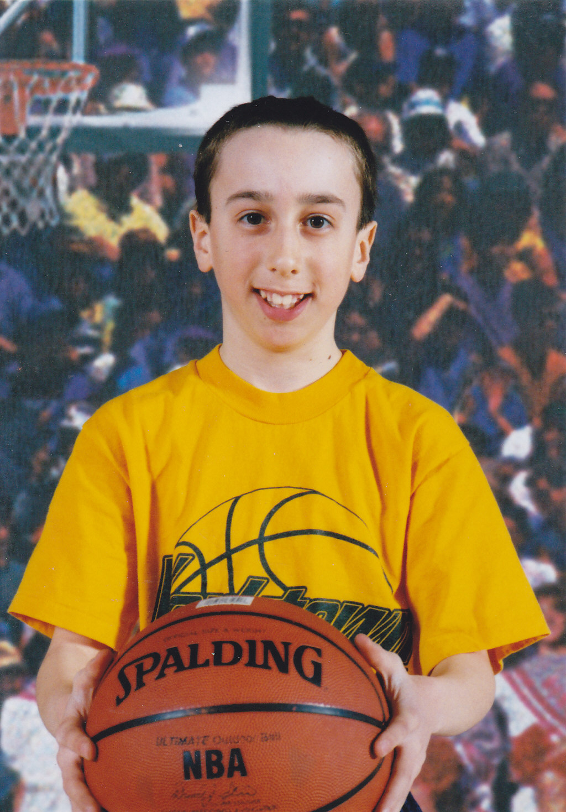

Slide 8
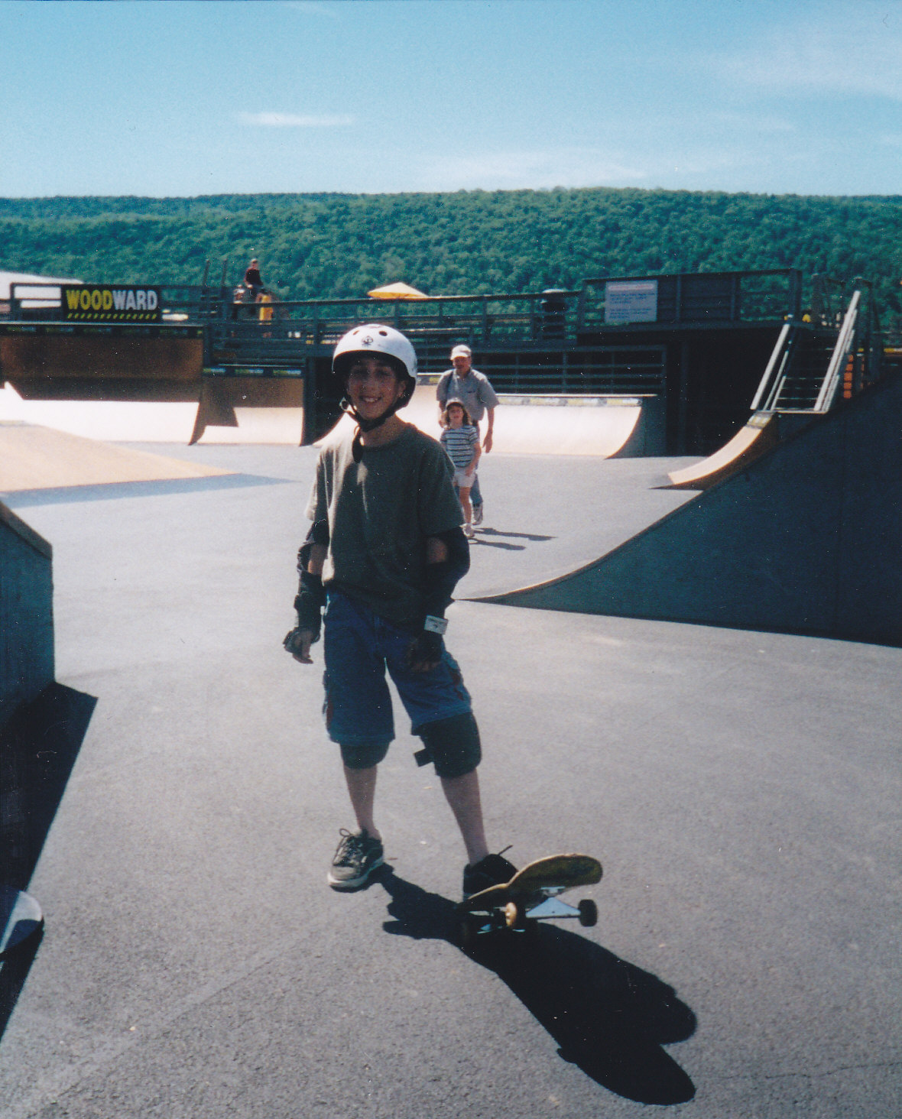

Slide 9
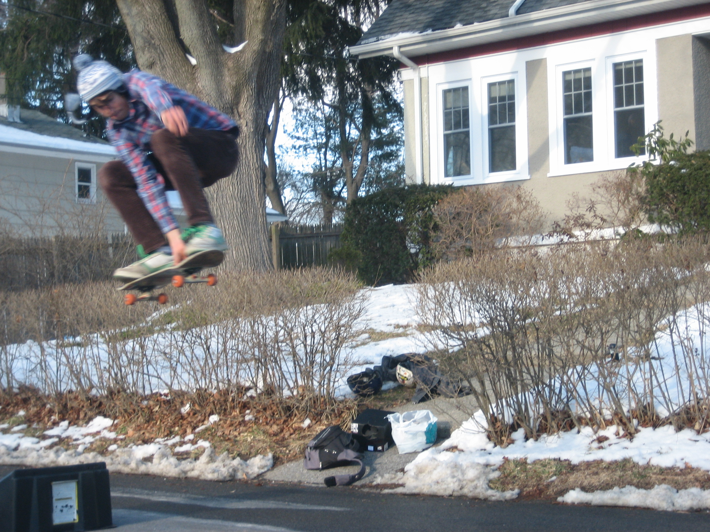
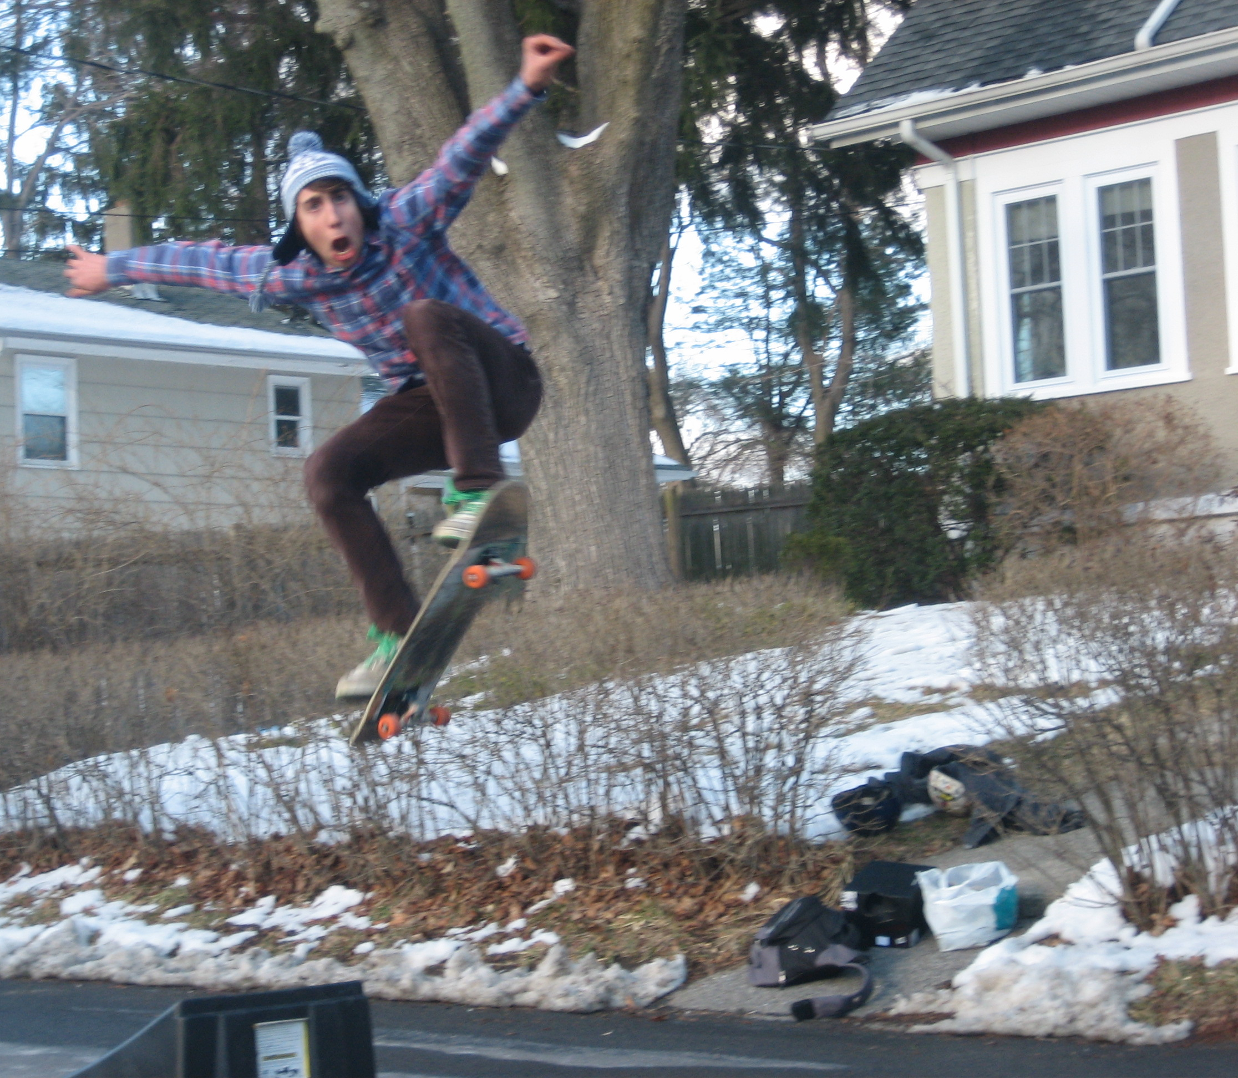

Slide 11
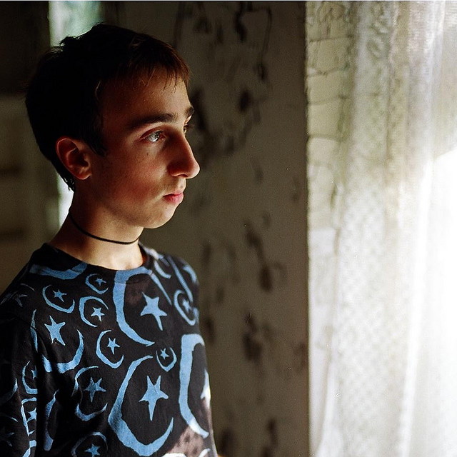

Slide 12
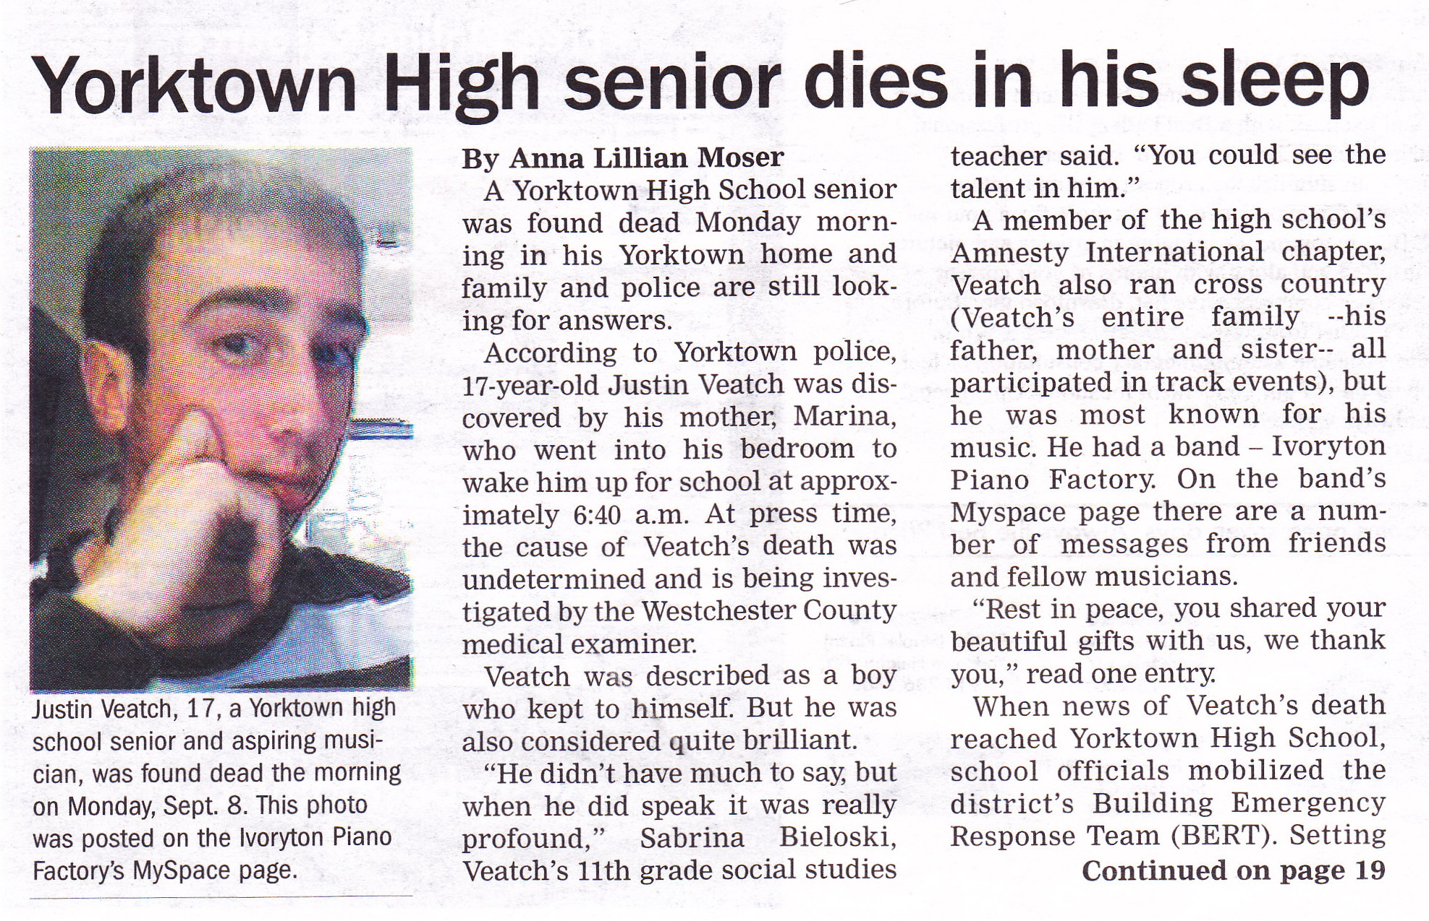

Slide 13
U.S. SURGEON GENERAL
28,647 died in 2014
(78/Day)

Slide 14
U.S. SURGEON GENERAL
20.8 Million Suffer Substance Abuse Disorder
Only 1 in 10 Treated

Slide 15
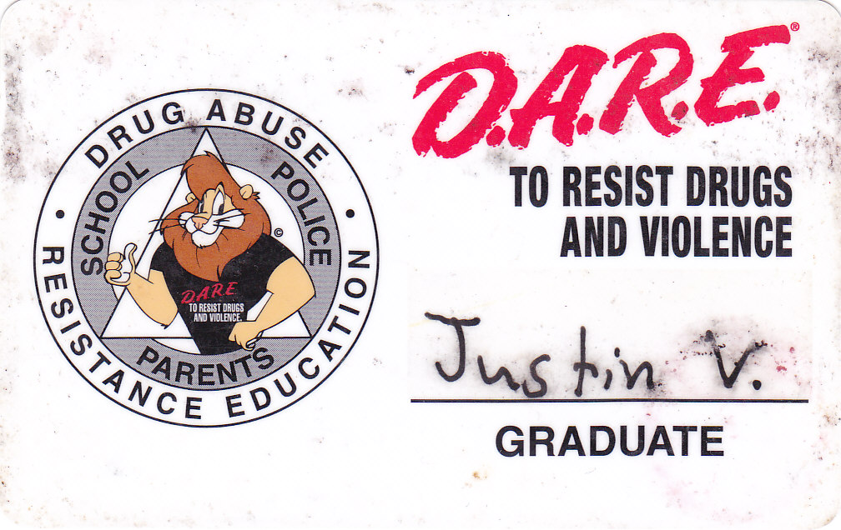

Slide 16
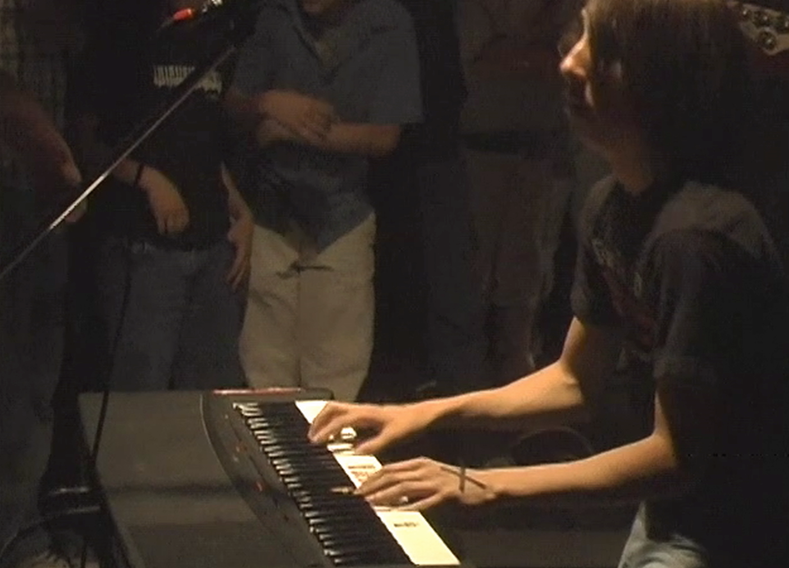

Slide 17
TEEN YEARS,
AN EVOLUTION
New Challenges
The Buffet of Life
New Choices
New Friends

Slide 18
NEW PLAYERS
IN YOUR LIFE
Tobacco
Prescription Drugs
Pot
Alcohol

Slide 19
Marijuana

Slide 20
WOW, THAT WAS GOOD

Slide 21
JUSTIN’S
EXPERIMENT

Slide 22
TOO GOOD
TO BE TRUE

Slide 23
SUBSTANCES IMPACT BRAIN CHEMISTRY
Sleep Disorders | Depression
Impaired Concentration | Real Pain
Lack of Motivation | Addiction

Slide 24
ROLE OF GENETICS
Genetics account for 50-75% of addiction

Slide 25
Marijuana—Justin’s Gateway

Slide 26
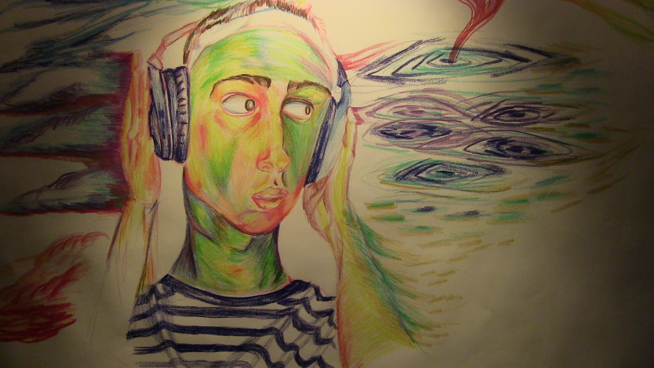
A MESSAGE FROM JUSTIN
Presented by Jeffrey Veatch

Slide 27
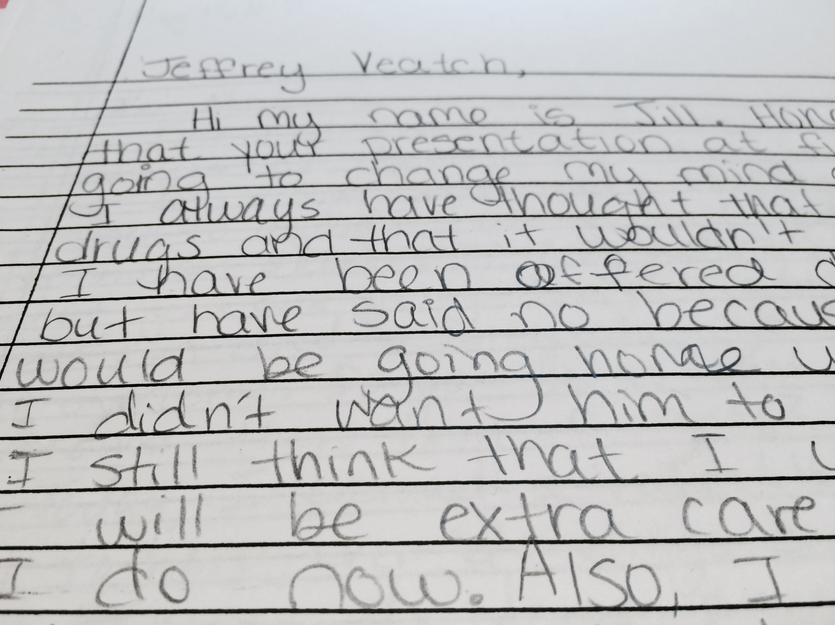

Slide 31
Marijuana

