Slide 1
Marijuana Legalization: Where Do We Go From Here?
A review of the evidence
Kevin A. Sabet, Ph.D.
Director, Drug Policy Institute, University of Florida
Director, Project SAM (Smart Approaches to Marijuana)
www.learnaboutsam.org

Slide 2
What are our choices for marijuana policy?

Slide 3
All or Nothing?
Legalization vs. Incarceration-Only

Slide 4
The groups pushing for marijuana legalization have found a way to make their issue resonate with everyday people.

Slide 5
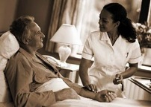
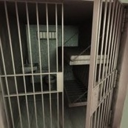
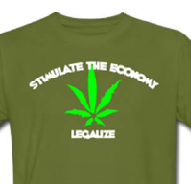
They have reframed the issue so it is about:
Voting for compassion for the sick and dying
Reducing our prison population and drug-related crime
Stimulating the economy

Slide 6
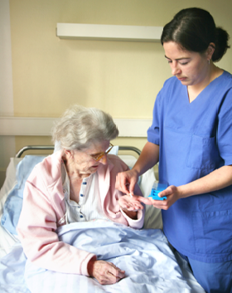

Slide 7
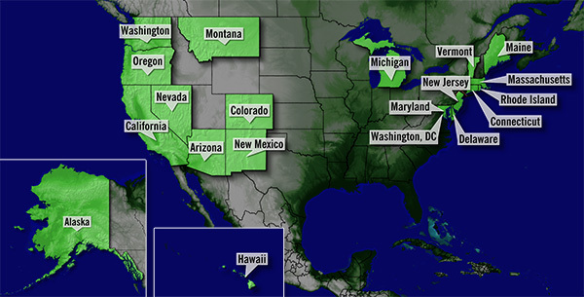

Slide 8
Advocates have organized across US states and around the world to push their initiatives.

Slide 9
They have major donors who fund their work and messages.

Slide 10
They’ve secured legislative champions at all levels – local, state, federal, international.

Slide 11
They’ve gotten the attention of editorial boards and media – including print, television and social media.

Slide 12
They’ve mobilized major grassroots and student supporters.

Slide 13
They are present and active in every single academic, think-tank, UN, and other international and domestic discussion on drug policy.

Slide 14
Most of all: They have captured the “sensible” ground, boxing us in as extremists, old fashioned, and moralistic.

Slide 15
What has been the result of their framing of this issue?

Slide 16
Generational trends in support for legalization in the US (Caulkins)
Percentage Favoring Legalization
Notes:
Over time, younger generations will become the main voters. Over the long term, voter turnover will lead to the rise of a generation that, following recent trends, will be more amenable to legalization efforts.
I think you should flag how the generation gap has shrunk, as well as the fact that some still remains.
Support among boomers has been more volatile

Slide 17
Support for Marijuana Legalization in the United States Has Reached Unprecedented Levels
Sources: Gallup http://bit.ly/olrSEQ and GSS

Slide 18
In one mathematical model, legalization reaches 70% support in 5 years…

Slide 19
Legalization is now a reality in the world.
And it is gaining support in the US every year.

Slide 20
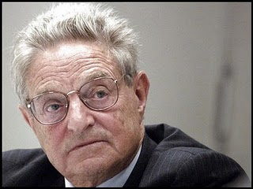
Spent over $250 Million on Legalization

Slide 21
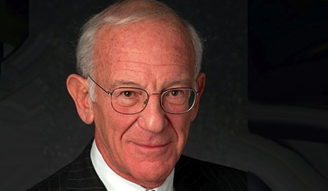
The National Organization for the Reform of Marijuana Laws estimates that Peter Lewis has spent between $40 million and $60 million funding legalization of marijuana campaigns since the 1980s.

Slide 22
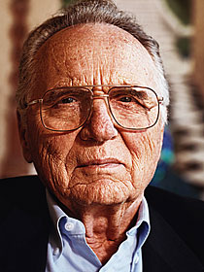
John Sperling
Over $50 Million

Slide 23
Factors Leading to Increase in Support
We have been outspent
We have a major messenger problem
(generational familiarity)
They are seen and framed as
sensible alternative

Slide 24
We Are Often on the Defensive
We have not admitted where we have drug policy challenges.
Nontraditional groups have rejected our message.
Our message has become stale: “Party of No”.

Slide 25
We Risk Losing Key Groups Traditionally Against Legalization
…racial minorities
…women/soccer moms
…new immigrants
…Independents
…Conservatives

Slide 26
And now two US states have legalized marijuana

Slide 27
When presented with “regulation” and a “new approach” in the form of legalization, more and more groups are choosing that over the “old way” of “prohibition” – which is associated with a “moralistic” drug policy grounded in fear and
“Reefer Madness”

Slide 28
This is a MIScharacterization of our view
BUT THAT DOESN’T MATTER ANYMORE
Just like it doesn’t matter that no one actually serves prison time for pot…
“PERCEPTION IS REALITY”

Slide 29
We Need a REBRANDING
A “SMART APPROACH”
Not about legalization vs. incarceration
We can be against legalization
but also for health, education, and common-sense
We can be against discriminatory laws and practices too.
RECLAIM “REFORM!”

Slide 30
This is a about creating a PERMISSION STRUCTURE for others to support us.
Medical MJ gave people “permission” to support legalization
We need to give people “permission” to oppose it.

Slide 31
We Need
A “SMART APPROACH”
Not about legalization vs. incarceration
We can be against legalization
but also for health, education, and common-sense

Slide 32
Chair, Patrick J. Kennedy
Launched January 10th, Denver
Over 5,000 press mentions
Public Health Board of Trustees

Slide 33
To inform public policy with the science of today’s marijuana.
To have honest conversations about reducing the unintended consequences of current marijuana policies, such as lifelong stigma due to arrest.
To prevent the establishment of Big Marijuana that would market marijuana to children — and to prevent Big Tobacco from taking over Big Marijuana. Those are the very likely results of legalization.
To promote research of marijuana’s medical properties and produce pharmacy-attainable medications.

Slide 34
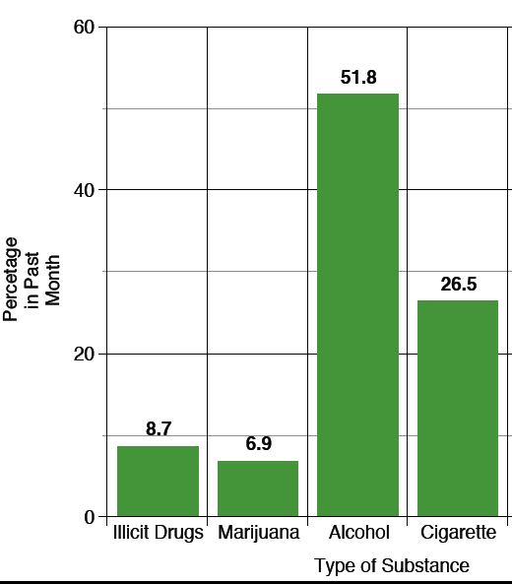
Current Uses of Major Substances in General Population, 2011
Substance Abuse and Mental Health Services Administration, Results from the 2011 National Survey on Drug Use and Health: Summary of National Findings, NSDUH Series H-44, HHS Publication No. (SMA) 12-4713. Rockville, MD: Substance Abuse and Mental Health Services Administration, 2012.

Slide 35
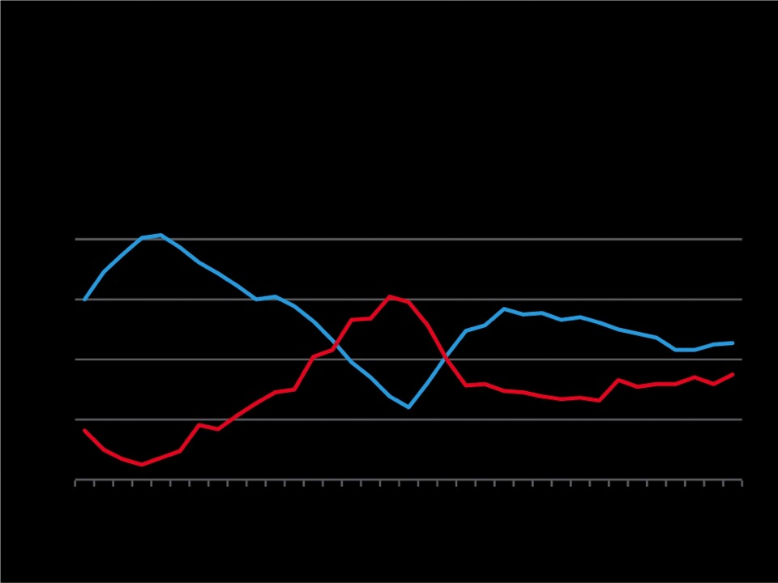
Changes in Perceptions Lead to Changes in Reality
MARIJUANA USE AND PERCEIVED RISK AMONG 12TH GRADERS, 1975 TO 2009
50%
Past Year Use
40%
30%
Perceived Risk
20%
10%
’75
’80
’85
’90
’95
’00
’05
Source: The Monitoring the Future study, the University of Michigan

Slide 36
Perception of Risk Associated with Consumption of Marijuana during Last Year
Drug Use in the Americas 2011 Report (CIDAD)
Uruguay
Prevalence of Use
Source: CICAD (2011) Informe del uso de drogas en las Américas 2011
Perception of Great Risk (%)
Greater perception of risk reduces consumption

Slide 37
Marijuana and Kids
The adolescent brain is especially susceptible to marijuana use.
That means that when kids use, they have a greater chance of
addiction since their brains
are being primed.
Giedd. J. N. (2004). Structural magnetic resonance imaging of the adolescent brain. Annals of the New York Academy of Sciences, 1021, 77-85.

Slide 38
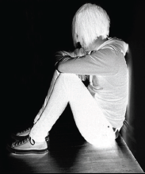
Marijuana’s Health Effects
Most people who use marijuana once
will stop, and not become addicted.
1 in 6 kids who
try marijuana
will become addicted.
For people who keep smoking marijuana, the health harms are underappreciated and costly.
Wagner, F.A. & Anthony, J.C. From first drug use to drug dependence; developmental periods of risk for dependence upon cannabis, cocaine, and alcohol. Neuropsychopharmacology 26, 479-488 (2002).

Slide 39
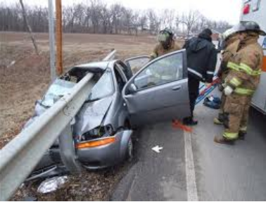
Marijuana’s Potential for Harm
This isn’t your Woodstock Weed – potency 5x stronger than in 1970s
Connected to changes in adolescent brain resulting in learning and memory problems, IQ loss, less life satisfaction
Doubles risk of car crash
Bronchitis/lung complications - Lung cancer link mixed; still learning
Mehmedic, Z., et, al. A. (2010), Potency Trends of Δ9-THC and Other Cannabinoids in Confiscated Cannabis Preparations from 1993 to 2008. Journal of Forensic Sciences, 55: 1209–1217
Giedd. J. N. (2004). Structural magnetic resonance imaging of the adolescent brain. Annals of the New York Academy of Sciences, 1021, 77-85.
M. Asbridge, J. A. Hayden, J. L. Cartwright. Acute cannabis consumption and motor vehicle collision risk: systematic review of observational studies and meta-analysis. BMJ, 2012; 344 (feb09 2): e536 DOI:
Tetrault, J.M., et al. Effects of cannabis smoking on pulmonary function and respiratory complications: a systematic review. Arch Intern Med 167, 221-228 (2007).

Slide 40
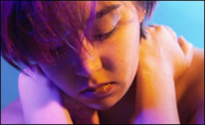
Relation to Mental Health
Increased risk of psychosis
Risk of schizophrenia increased six-fold
More treatment resistant
Cannabis use in adolescence and risk for adult psychosis: longitudinal prospective study Louise Arseneault, BMJ 2002;325:1212-1213 ( 23 November )
Andréasson S, Allebeck P, Engström A, Rydberg U. Cannabis and schizophrenia: a longitudinal study of Swedish conscripts. Lancet 1987; ii: 1483-1485.

Slide 41
Mehmedic et al., Potency Trends of D-9 THC and Other Cannabinoids in Conﬁscated Cannabis Preparations from 1993 to 2008, J Forensic Sci, September 2010, Vol. 55, No. 5. Seehttp://home.olemiss.edu/~suman/potancy%20paper%202010.pdf.
Psychoactive Ingredient

Slide 42
Let’s Not Repeat Mistakes of Alcohol & Tobacco
Use levels for alcohol and tobacco are much higher than marijuana
Industries promote addiction and target kids
Schiller JS, Lucas JW, Peregoy JA. Summary health statistics for U.S. adults: National Health Interview Survey, 2011. National Center for Health Statistics. Vital Health Stat 10(256). 2012.
Centers for Disease Control and Prevention. Vital Signs: Current Cigarette Smoking Among Adults Aged ≥ 18 Years—United States, 2005–2010. Morbidity and Mortality Weekly Report 2011;60(33):1207–12

Slide 43
What incentives do legal corporations have to keep price low and consumption high?
“Enjoy Responsibly”
Taxes today for alcohol are 1/5 of what they were during the Korean War (adj for inflation)
Cook, P. J. (2007). Paying the tab: The economics of alcohol policy. Princeton, NJ: Princeton University Press.

Slide 44
Can we trust companies and
Big Corporations not to target youth and the vulnerable?

Slide 45
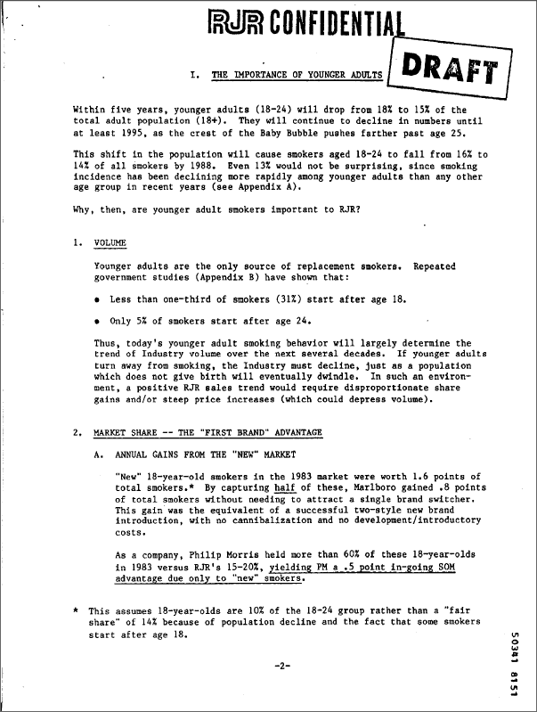
RJ Reynolds (1984 est.)
http://legacy.library.ucsf.edu/tid/eyn18c00

Slide 46
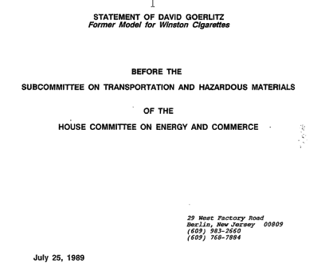
Tobacco Institute (1989)
http://legacy.library.ucsf.edu/tid/pvt37b00

Slide 47
RJ Reynolds (1973)
http://legacy.library.ucsf.edu/tid/mqu46b00

Slide 48
Brown & Williamson (1972)
http://legacy.library.ucsf.edu/tid/wwq54a99

Slide 49
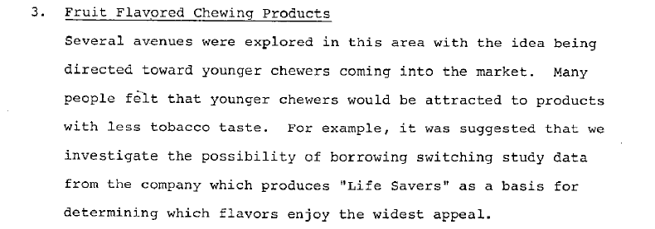
Lorillard (1979)
http://legacy.library.ucsf.edu/tid/sdw88c00

Slide 50
“The use of marijuana ... has important implications for the tobacco industry in terms of an alternative product line. (We) have the land to grow it, the machines to roll it and package it, the distribution to market it. In fact, some firms have registered trademarks, which are taken directly from marijuana street jargon. These trade names are used currently on little-known legal products, but could be switched if and when marijuana is legalized. Estimates indicate that the market in legalized marijuana might be as high as $10 billion annually.” From a report commissioned by cigarette manufacturer Brown and Williamson (now merged with R.J. Reynolds) in the 1970s.

Slide 51
Will Big Marijuana become the new Big Tobacco?
Lessons from Colorado

Slide 52
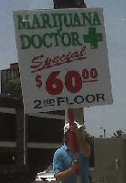
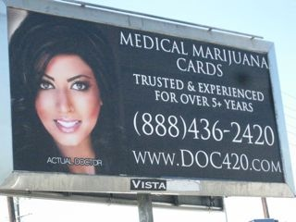

Slide 53
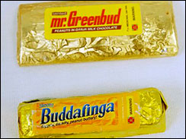
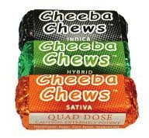
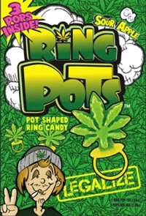
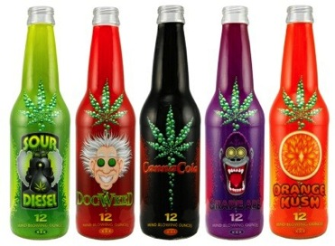
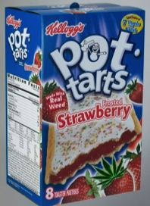
Marketing to Children

Slide 54
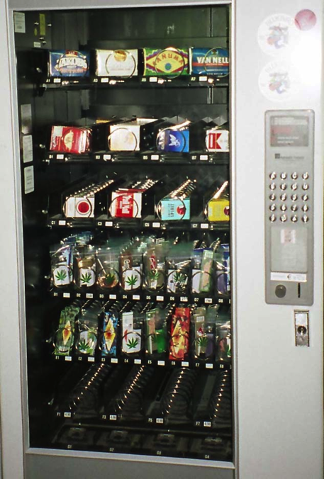

Slide 55
Past month prevalence of marijuana use –
12+ yrs
12.2
9.62
7.88
6.0
6.6
6.1
55
Source: National Survey on Drug Use and Health
Notes:
55

Slide 56
Number substance treatment admissions for marijuana - Denver metro
Med. MJ Dispensaries/Commercializaition
Colorado
#
Denver
Source: Drug/Alcohol Coordinated Data System

Slide 57
Use of “regulated” marijuana by Denver teens
%
%
%
%
Substance treatment = 74% YES
Primary Care=
72% NO
Source: Salomonse-Sautel et al. (2012), JAACAP 51:694-702; Thurstone et al., under review
57
Notes:
57

Slide 58
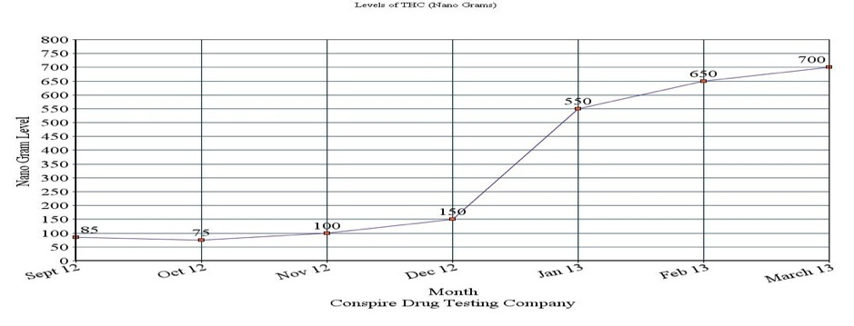
Colorado: Drug Testing Company Sees Spike in Children Using Marijuana
Levels of THC (Nano Grams) after passage of Amendment 64:
CBS4 - McGuire, Jo. Drug Testing Company Sees Spike In Children Using Marijuana, Denver Post, March 6, 2013
High School Student: “I’ve seen a lot more people just walking down the street smoking (joints)…it has kind of gotten out of hand.”
Passage of Legalization

Slide 59
Average urine drug screen results
Ng/ml
59
Source: Thurstone et al., in preparation
Notes:
59

Slide 60
CO Traffic Fatalities with a THC+ driver
#

Slide 61
Drug-Related Suspensions/Expulsions - Colorado
Med. MJ Dispensaries/Commercializaition
#
61
Source: Colorado Department of Education
Notes:
61

Slide 62
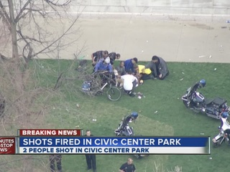
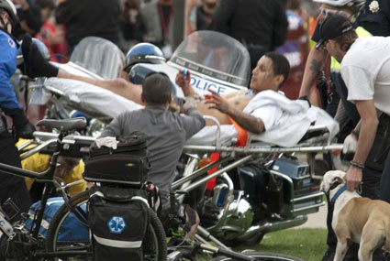
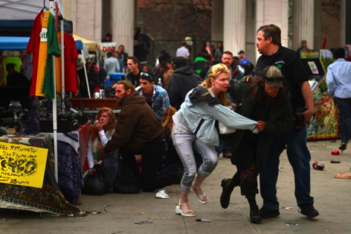
4/20 Rally in Denver

Slide 63
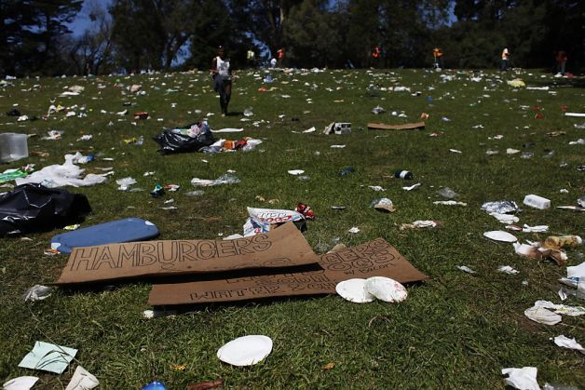
4/20 Rally in San Francisco

Slide 64
Responsible Regulations?
Heavily influenced by CO’s massive medical marijuana industry
Allowing character packaging, edibles, candies
Can grow much more than you sell
Advertising allowed in “Adult Periodicals”

Slide 65
The Straight Facts on Marijuana

Slide 66
Alcohol & Tobacco Money Makers or Dollar Drainers
Alcohol Costs
T obacco Costs
$185
billion
$200
billion
Costs
$14 billion
$25 billion
Revenues
Revenues
State estimates found at http://www.nytimes.com/2008/08/31/weekinreview/31saul.html?em; Federal estimates found at https://www.policyarchive.org/bitstream/handle/10207/3314/RS20343_20020110.pdf; Also see http://www.tobaccofreekids.org/research/factsheets/pdf/0072.pdf; Campaign for Tobacco Free Kids, see “Smoking-caused costs,” on p.2.

Slide 67
“If Only We Treated It Like Alcohol…”
2.7 million
Arrests for alcohol-related crimes in 2008
847,000
Marijuana-related arrests in 2008
(Does NOT include violence;
Includes violations of liquor laws and driving under the influence)
Federal Bureau of Investigation (2008) UniformCrime Reports, Washington,DC. http://www.fbi.gov/ucr/ucr.htm

Slide 68
Heavy Marijuana Use Lowers IQ¹
FACTS:
More Drug Use = More Problems
A recent study found that those who used cannabis heavily in their teens and continued through adulthood showed a permanent drop in IQ of 8 points.
A loss of 8 IQ points could drop a person of average intelligence into the lowest third of the intelligence range.
¹M.H. Meier, Avshalom Caspi, et al. 2012. “Persistent cannabis users show neuropsychological decline from childhood to midlife.” Proceedings of the National Academy of Sciences

Slide 69
Kilmer, Beau, Jonathan P. Caulkins, Rosalie Liccardo Pacula, Robert J. MacCoun and Peter H. Reuter. 2010. “Altered State? Assessing How Marijuana Legalization in California Could Influence Marijuana Consumption and Public Budgets.” Santa Monica, CA: RAND Corporation, http://www.rand.org/pubs/occasional_papers/OP315.
Legalization = Cheaper Drugs = More Use
RAND Study:
Pre-Tax Price Could Drop More Than 80%
Consumption Will Increase
Tax evasion a major concern

Slide 70
Fixing Current Policy
People should not be stigmatized for their past use
No sense in incarcerating users
People need job and economic opportunities; by being blocked from them they will re-enter the illicit market

Slide 73
Is marijuana medicine?

Slide 74
Current Situation
Less than 3% of state “medical marijuana” users have cancer, HIV, or glaucoma.
Could exacerbate symptoms (American Glaucoma Society)
Vast majority are white males in 30s and 40s with self-diagnosed pain.
Vast majority of cancer doctors and other physicians do not recommend smoking or ingesting marijuana.
California average medical marijuana patient statistics, found at: O'Connell, T and Bou-Matar , C.B. (2007). Long term cannabis users seeking medical cannabis in California (2001–2007): demographics, social characteristics, patterns of cannabis and other drug use of 4117 applicants. Harm Reduction Journal,

Slide 75
Current Situation
Relative to areas without them, areas with medical marijuana “dispensaries” connected to crime, youth access, and increased abuse.
Voting on medicine? Bypassing scientific, FDA process, in favor of larger political and legalization agendas.
Most major medical groups oppose state-based smoked marijuana as medicine (eg AMA, ACS).

Slide 76
This doesn’t mean that components
in marijuana do not have medical properties.
These are being scientifically developed.
However, the process should be improved.

Slide 77
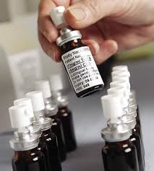
Cannabis-Based Medicines
Research on the efficacy of cannabinoids is not focused on raw/crude marijuana, but in the individual components that may have medical use.
Sativex is in the process of being studied
Approved in Canada and across Europe
Administered via an oral mouth spray, THC:CBD - 1:1
Bayer Health. Fact Sheet – Sativex. April 13, 2005.
http://www.hc-sc.gc.ca/dhp-mps/prodpharma/notices-avis/conditions/sativex_fs_fd_091289-eng.php

Slide 78
We don’t smoke opium to benefit from morphine.
So we don’t need to smoke marijuana to receive its potential benefits.

Slide 79
We need to decrease access and availability.
So, a smart approach might look like this:
Increased community-based prevention through community coalitions to empower schools, parents, physicians and other health care professionals to prevent marijuana use among youth
Increased screening and brief interventions in health care settings
Increased access to treatment
Increased access to recovery-oriented services
Greater number of drug treatment courts and HOPE Probation programs

Slide 80
Thank You!
Questions?
www.kevinsabet.com
www.learnaboutsam.org
Email
info@learnaboutsam.org
kevin@learnaboutsam.org

